Slide 1




Who Needs Another Tutorial on Risk or Decision Rules?
Greg Cenker & Henry Zumbrun
2023 ASQ Measurement Quality Division Conference
“Improving Measurement Confidence and Reducing Risk”
Sheraton Suites – Cuyahoga Falls, Ohio

Slide 2


Who Needs Another Tutorial on Risk or Decision Rules?
Henry Zumbrun II, Morehouse Instrument Company
1742 Sixth Ave
York, PA 17403
PH: 717-843-0081 web: www.mhforce.com
sales: hzumbrun@mhforce.com

Slide 3


Who Needs Another Tutorial on Risk or Decision Rules?
Greg Cenker, Indysoft
146 Fairchild St, Suite 202.
Daniel Island, SC 29492
web: www.indysoft.com
greg.cenker@indysoft.com

Slide 4
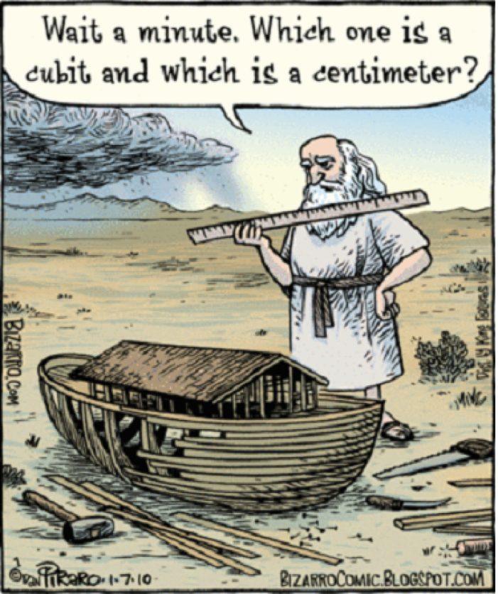

Slide 5
Abstract
This 4-hour tutorial will help the participant eliminate much of the noise on decision rules. It will provide guidance anyone can take away and implement in their laboratory. This session aims to give guidance beyond simply requesting a 4:1 TUR (antediluvian) or accepting a shared-risk scenario as with simple acceptance.
When a calibration report is provided, a typical concern for the customer is to know if the item calibrated is within the tolerance specified so they can continue using the device (i.e., many want a new sticker ☺).
While this long-established approach has been in service since 1955, measurement science has evolved (or not?). With our technological evolution, a simple “pass/fail” may no longer be enough.

Slide 6
Learning Objectives
Understanding Measurement Traceability Requirements.
Know the Fundamentals of Measurement Uncertainty.
Understanding Measurement Data Sampling Requirements.
Understanding the Basics of Decision Rules.
Know the Differences and Applications for Specific and Global Risk Models.
Introduction to Metrology Costing Models.

Slide 7
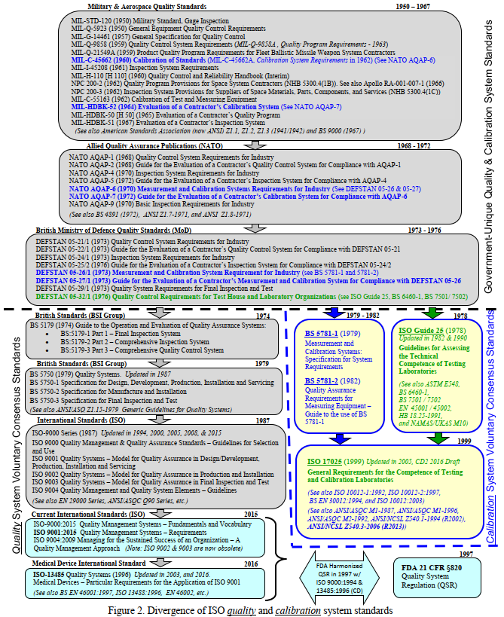
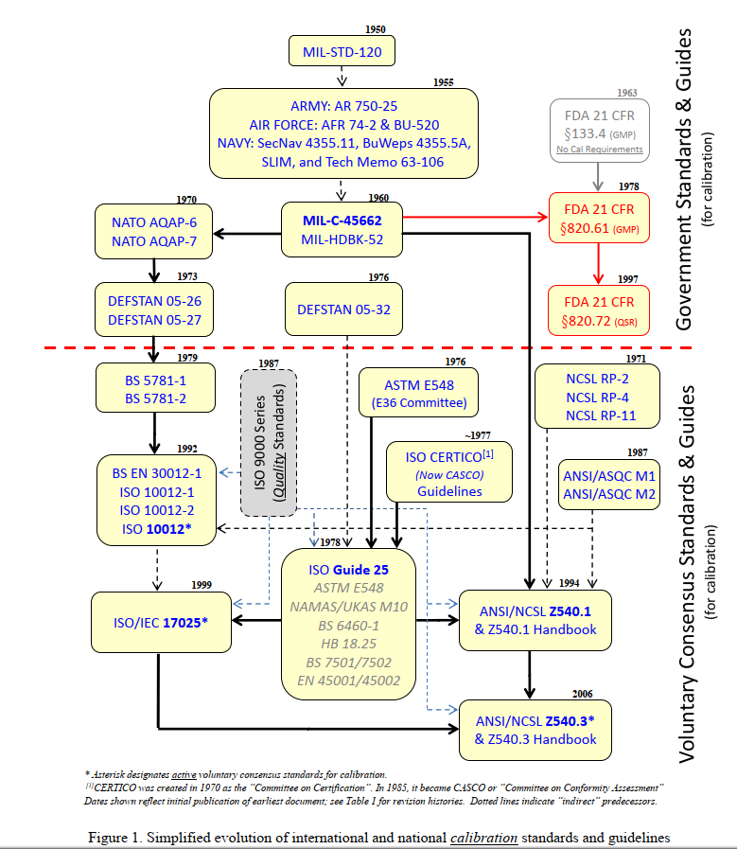
History
From Calibration in Regulated Industries:
Federal Agency use of ANSI Z540.3 and ISO 17025 – P.Reese

Slide 8
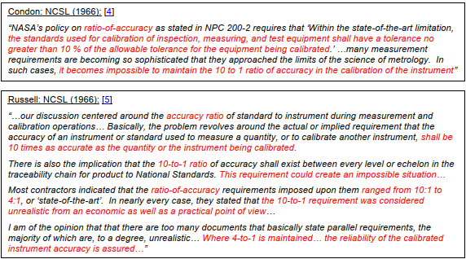
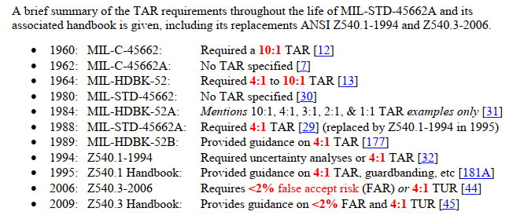
Where did the famous 4:1 Requirement Come From?
Origins of the ubiquitous 4:1 test accuracy ratio have been and attributed to Hayes and Crandon of the U.S. Navy in the mid-1950s. Hayes published the first known statistical analysis of calibration quality (false accept/reject) in 1955, invoking the concept of accuracy ratios, based primarily on the 1954 seminal works of Eagle and Grubbs & Coon.

Slide 9
Introduction - First efforts at reducing measurement risk
Modern measurement decision risk traces its roots to the late 1940’s and early 1950's.
  Alan Eagle
  Frank Grubbs, and Helen Coon
Eagle's 1954 paper focused on methods to analyze, quantify, and mitigate “test errors”
  methods for calculating consumer and producer risk.
  methods for establishing “test limits,” referred to as Guard Bands today.
Grubbs and Coons, in the same publication, expanded on Eagle’s paper
  methods for balancing consumer and producer risk for measurement-based decisions.
These papers were the genesis of requirements found in standards such as MIL-STD 45662, ANSI/NCSL Z540.1, ANSI/NCSL Z540.3, ASME B89.7.4.1-2005, and JCGM 106:2012, as well as other National and International standards and papers.

Slide 10
Introduction - First efforts at reducing measurement risk
In 1955, the U.S. Navy needed improved measurement reliability in their guided missile program.
In response, Jerry Hayes authored Technical Memorandum No. 63-106. Aspects of this document are still relevant today.
  Calibrated equipment needed for testing
  Establishment of reasonable testing risk levels
  Reasonable design tolerances
  Adequate procedures for testing
Using Eagle’s work, Hayes proposed a “family of curves” to determine specific testing risk
  A new family of curves had to be established for each change in process or design tolerance
  Computing consumer risk was very arduous with slide rules
With a lack of computing power in 1955, a 4:1 accuracy ratio was established as Navy policy
  Established for a 1% Consumer Risk objective
  Assumed the test equipment and calibration standard manufacturing specifications were developed for a 95% confidence level
This is the origin of the Test Accuracy Ratio (TAR) used in calibration and testing for decades.

Slide 11
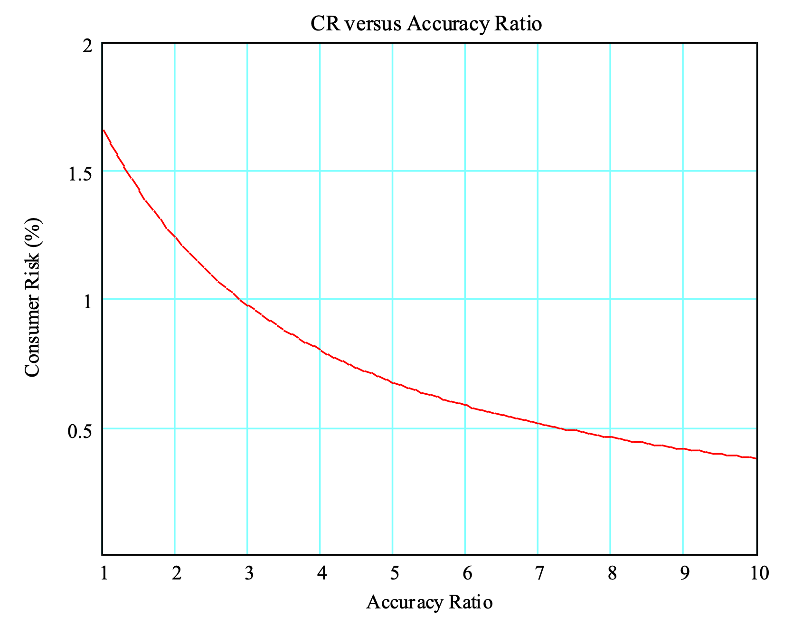


Introduction – The 4:1 Rule and Measurement Risk
The accuracy ratio in the Eagle equation was a ratio of two standard deviations.
The numerator σ_{x} is “the true standard deviation of the product distribution.”
The denominator σ_{e} is “the standard deviation of the errors of measurement.”
$$r=\frac{σ_{x}}{σ_{e}}$$
$$CR=\frac{1}{π}∫_{k}^{∞}∫_{−r(k+t)+b}^{r(k−t)+b}e^{\frac{−(t^{2}+s^{2})}{2}}dsdt$$
Assuming a 95% confidence level for each, Hayes used specifications for the “test ratio.”
The numerator would be UUT specifications, and
the denominator the Calibration Standards.
The intent was to use procedure controls to mitigate other “measurement errors” during testing.
Not fully trusting all specs were equal, Hayes and Crandon increased the ratio to 4:1.
Therefore, the 4:1 Rule provides a specific level of risk only under explicit assumptions and conditions.
At approximately a 3:1 TAR, the target 1% CR was achieved.
k = 2

Slide 12
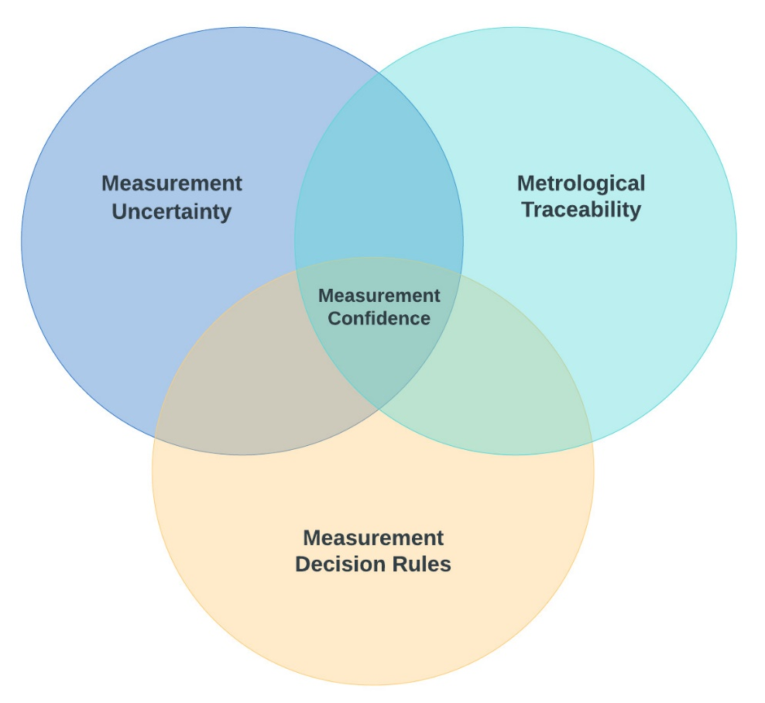
Measurement Confidence

Slide 13
ISO/IEC 17025:2017 Requirement
6.5 Metrological traceability
6.5.1 The laboratory shall establish and maintain metrological traceability of its measurement results by means of a documented unbroken chain of calibrations, each contributing to the measurement uncertainty, linking them to an appropriate reference.
NOTE 1 In ISO/IEC Guide 99, metrological traceability is defined as the “property of a measurement result whereby the result can be related to a reference through a documented unbroken chain of calibrations, each contributing to the measurement uncertainty”.
NOTE 2 See Annex A for additional information on metrological traceability.
Notes:
Highlight only the important parts

Slide 14
Measurement Related Terms
Metrological Traceability: Property of a measurement result whereby the result can be related to a reference through a documented unbroken chain of calibrations, each contributing to the measurement uncertainty.
  NOTE 1 For this definition, a ‘reference’ can be a definition of a measurement unit through its practical realization, or a measurement procedure including the measurement unit for a non-ordinal quantity, or a measurement standard.
  NOTE 2 Metrological traceability requires an established calibration hierarchy.
  NOTE 3 Specification of the reference must include the time at which this reference was used in establishing the calibration hierarchy, along with any other relevant metrological information about the reference, such as when the first calibration in the calibration hierarchy was performed.
  NOTE 4 For measurements with more than one input quantity in the measurement model, each of the input quantity values should be metrologically traceable.

Slide 15
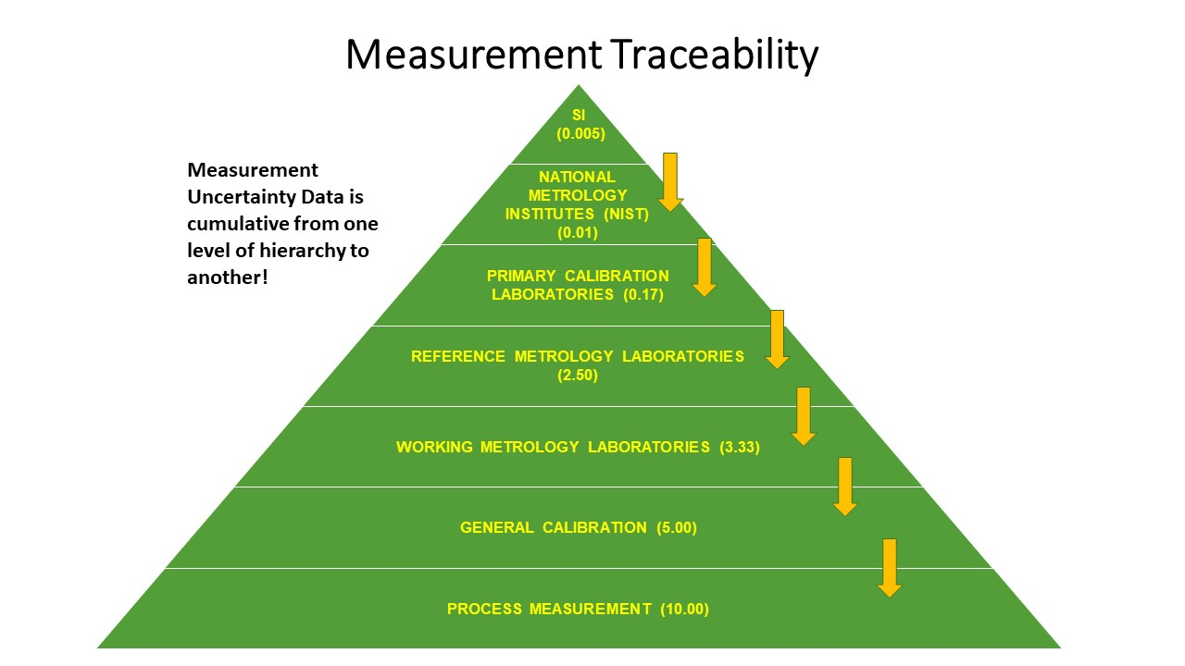

Slide 16
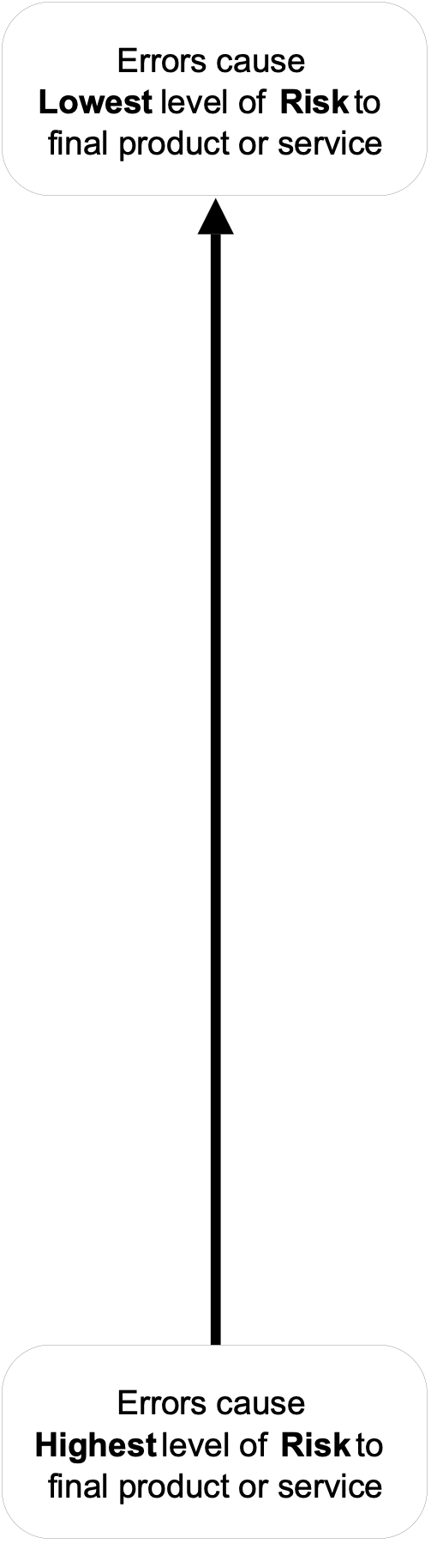
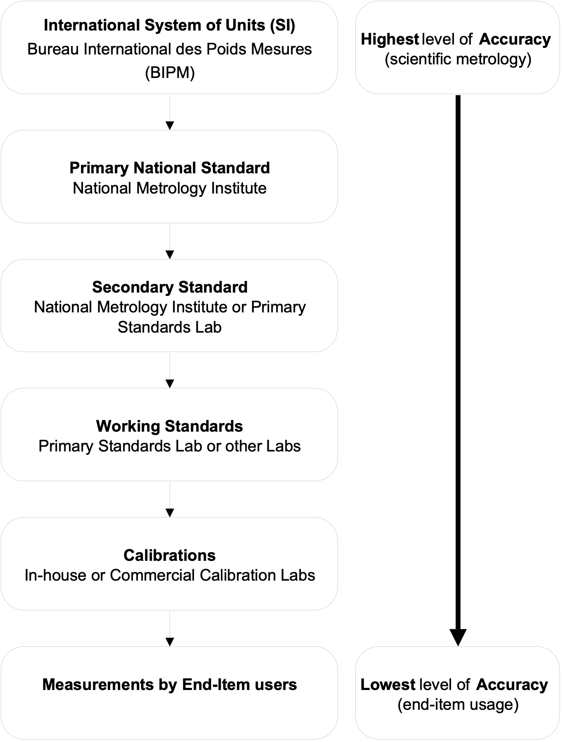
Measurement Accuracy, Risk, and the Metrology chain
Quality requirements must ensure the measurement will support the decision
A perfect instrument does not guarantee a “good” measurement…
Calibration requirements must ensure measuring and test equipment are acceptable and ready for use by end-users

Slide 17
Measurement Uncertainty’s Relation to Measurement Hierarchy
SI
Uncertainty
Typical Uncertainties for Force Measurement k =1
NIST = 0.0004 – 0.0005 %
Morehouse = 0.0008 %
Accredited Calibration Supplier = 0.02 %
Working Standards = 0.1 %
Field Measurement = 0.5 %
National Metrology Institute (NMI)
Measurement Uncertainty Data is cumulative from one level of hierarchy to another!
Primary Reference Laboratory
Morehouse Instrument Company
Accredited Calibration
Service Supplier
Working Standards Instrument/Equipment
Field Measurement

Slide 18
Measurement Uncertainty
7.6 Evaluation of measurement uncertainty
7.6.1 Laboratories shall identify the contributions to measurement uncertainty. When evaluating
measurement uncertainty, all contributions that are of significance, including those arising from
sampling, shall be taken into account using appropriate methods of analysis.
7.6.2 A laboratory performing calibrations, including of its own equipment, shall evaluate the
measurement uncertainty for all calibrations.
7.6.3 A laboratory performing testing shall evaluate measurement uncertainty. Where the test method
precludes rigorous evaluation of measurement uncertainty, an estimation shall be made based on an
understanding of the theoretical principles or practical experience of the performance of the method.
NOTE 1 In those cases where a well-recognized test method specifies limits to the values of the major sources
of measurement uncertainty and specifies the form of presentation of the calculated results, the laboratory is
considered to have satisfied 7.6.3 by following the test method and reporting instructions.
NOTE 2 For a particular method where the measurement uncertainty of the results has been established and
verified, there is no need to evaluate measurement uncertainty for each result if the laboratory can demonstrate
that the identified critical influencing factors are under control.
NOTE 3 For further information, see ISO/IEC Guide 98-3, ISO 21748 and the ISO 5725 series.

Slide 19
Introduction - Measurements, Uncertainty, and Specifications
Measurement Uncertainty: The doubt that exists about a measurement’s result
Every measurement—even the most careful—always has a margin of doubt
Uncertainty is the inherent limitation of a measurement process, due to instrumentation and process variation
Measurement uncertainty does not include mistakes
+ L
C’
A’
B
Nominal
A
C
Range of possible values at 95% confidence
- L

Slide 20
Measurement Uncertainty
CMC is defined as Calibration and Measurement Capability. It often includes the following standard uncertainty contributors:
Repeatability
Resolution
Reproducibility
Reference Standard Uncertainty
Reference Standard Stability
Environmental Factors
7.6.1 Laboratories shall identify the contributions to measurement uncertainty. When evaluating
measurement uncertainty, all contributions that are of significance, including those arising from
sampling shall be taken into account using appropriate methods of analysis.

Slide 21
Measurement Uncertainty
Let us examine CMC (Calibration Measurement Capability) using a primary standard as the reference and how it affects the Expanded Uncertainty. A Primary Standard as the Reference (CMC 0.0016 % for k = 2 or 0.16 lbf @ 10K)
14.43 % Contribution

Slide 22
Measurement Uncertainty
Let’s examine CMC (Calibration Measurement Capability) using a secondary standard as the reference and how it affects the Expanded Uncertainty. Accredited Calibration Supplier with Secondary Standards as the Reference (CMC 0.04 % for k = 2 or 4 lbf)
95.74 % Contribution

Slide 23
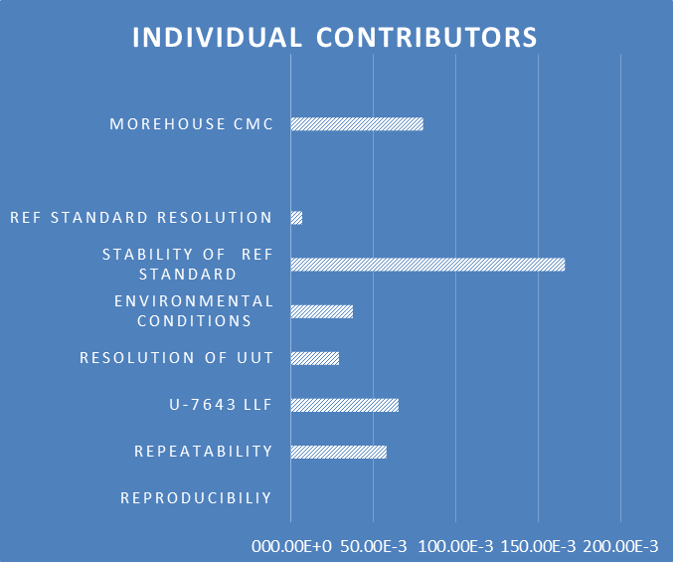
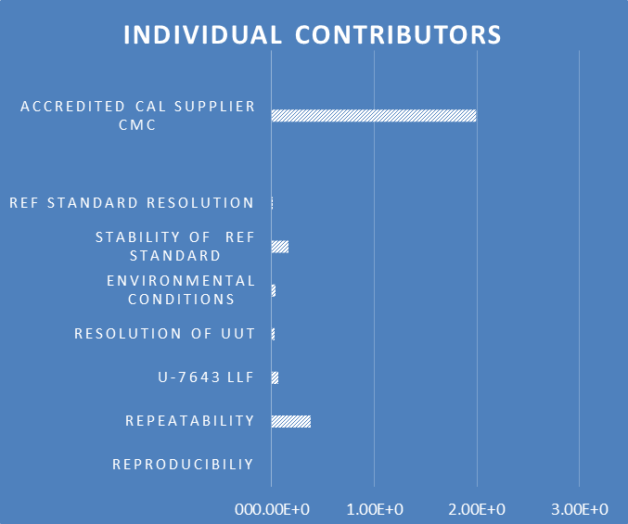
Measurement Uncertainty
Let’s examine CMC (Calibration Measurement Capability) and what the Reference CMC does to the calibration results. Deadweight Primary Standard Versus Secondary Standards
Expanded Uncertainty when calibrated with Primary Standards is approximately 10 times lower than using secondary standards
Expanded Uncertainty @ 10K = 0.41 lbf
Morehouse CMC = 0.16 lbf
Repeatability = 0.057 lbf
Expanded Uncertainty @ 10K = 4.03 lbf
Accredited Cal Supplier CMC = 4.00 lbf
Repeatability = 0.379 lbf

Slide 24
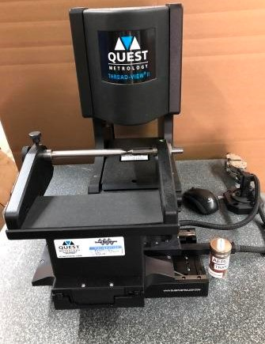
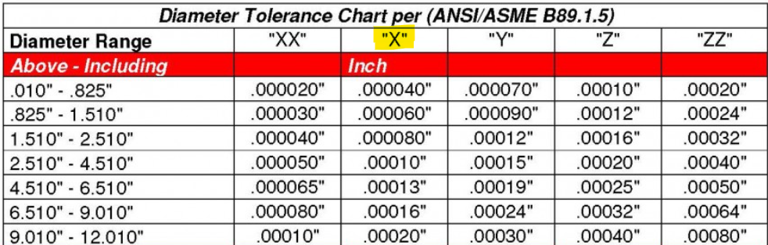
Metrological Traceability Review

Slide 25
Metrological Traceability Review
The resolution is1 µ inch
Master thread gauge had Measurement Uncertainty of 35 µ inch
Gage R & R was 7 µ inch
What would be the minimum uncertainty?

Slide 26






Metrological Traceability Review
$Resolution(R)=\frac{0.000 001}{\sqrt{12}}$
$$Master Thread Gauge(MTG)=\frac{0.000 035}{2}$$
$$Gage R\&R(G)=0.000 007$$
$$Uc=\sqrt{R^{2}+{MTG}^{2}+G^{2}}$$
$$Uc95=2×Uc$$
$$Uc95≅37.7μin$$

Slide 27
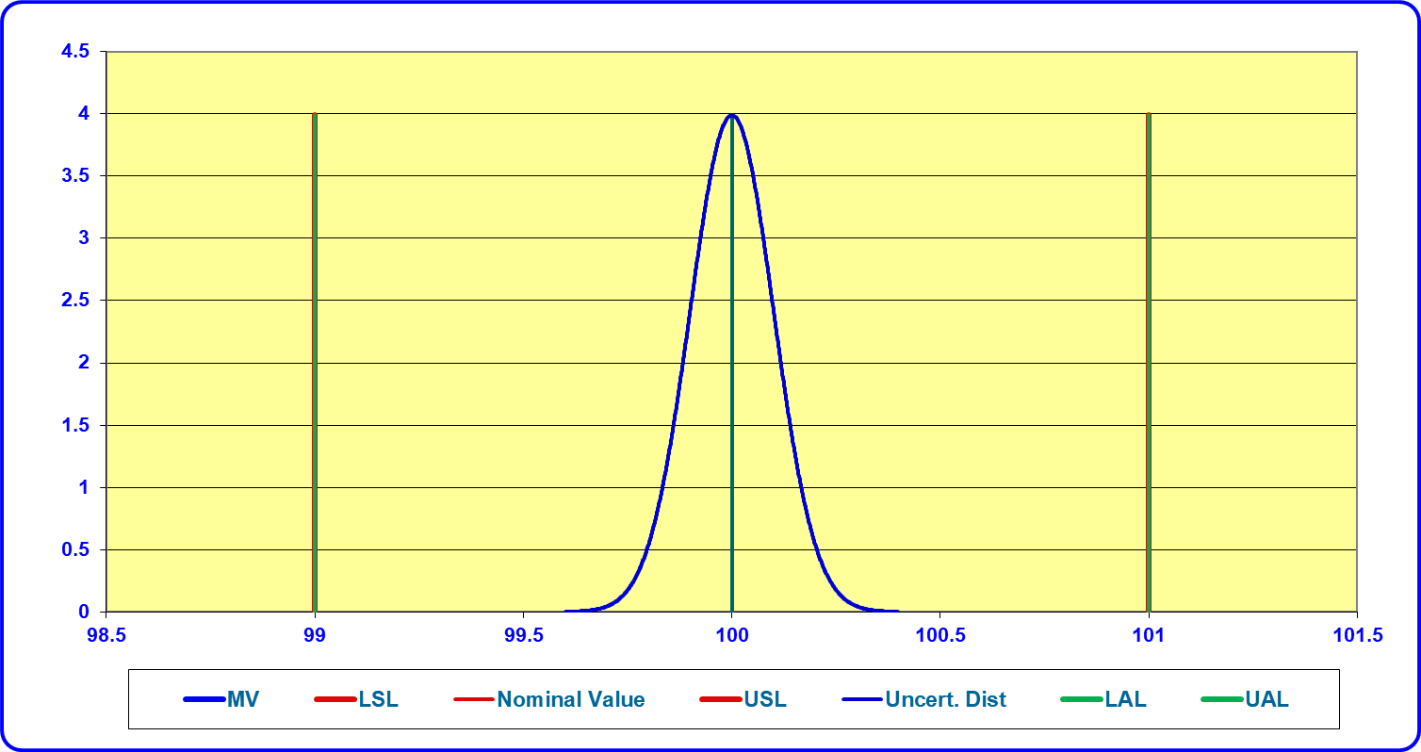
Tolerances
Tolerance: the total amount by which a specific characteristic
is permitted by specifications to vary.
NOTE: The tolerance is the difference between the upper and
lower specification limits tolerance interval: region between, and including, the tolerance
Tolerance limits: specified values of the characteristic, giving upper and/or lower bounds of the permissible value
A measurement quantity of 100 Volts has a tolerance of ±1 Volt. The measurement process used for calibration has an estimated 95 % expanded uncertainty of 0.2 Volts.
Notes:
ASME 2005 definition

Slide 28
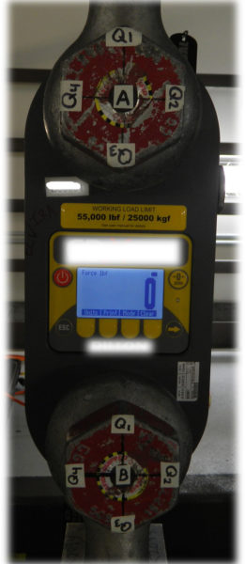
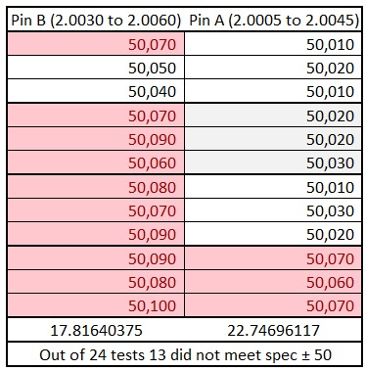
Tension Links – Tolerance?
PROPER PIN DIAMETER

Slide 29
The Problem With Averages
On average the results look similar!

Slide 30
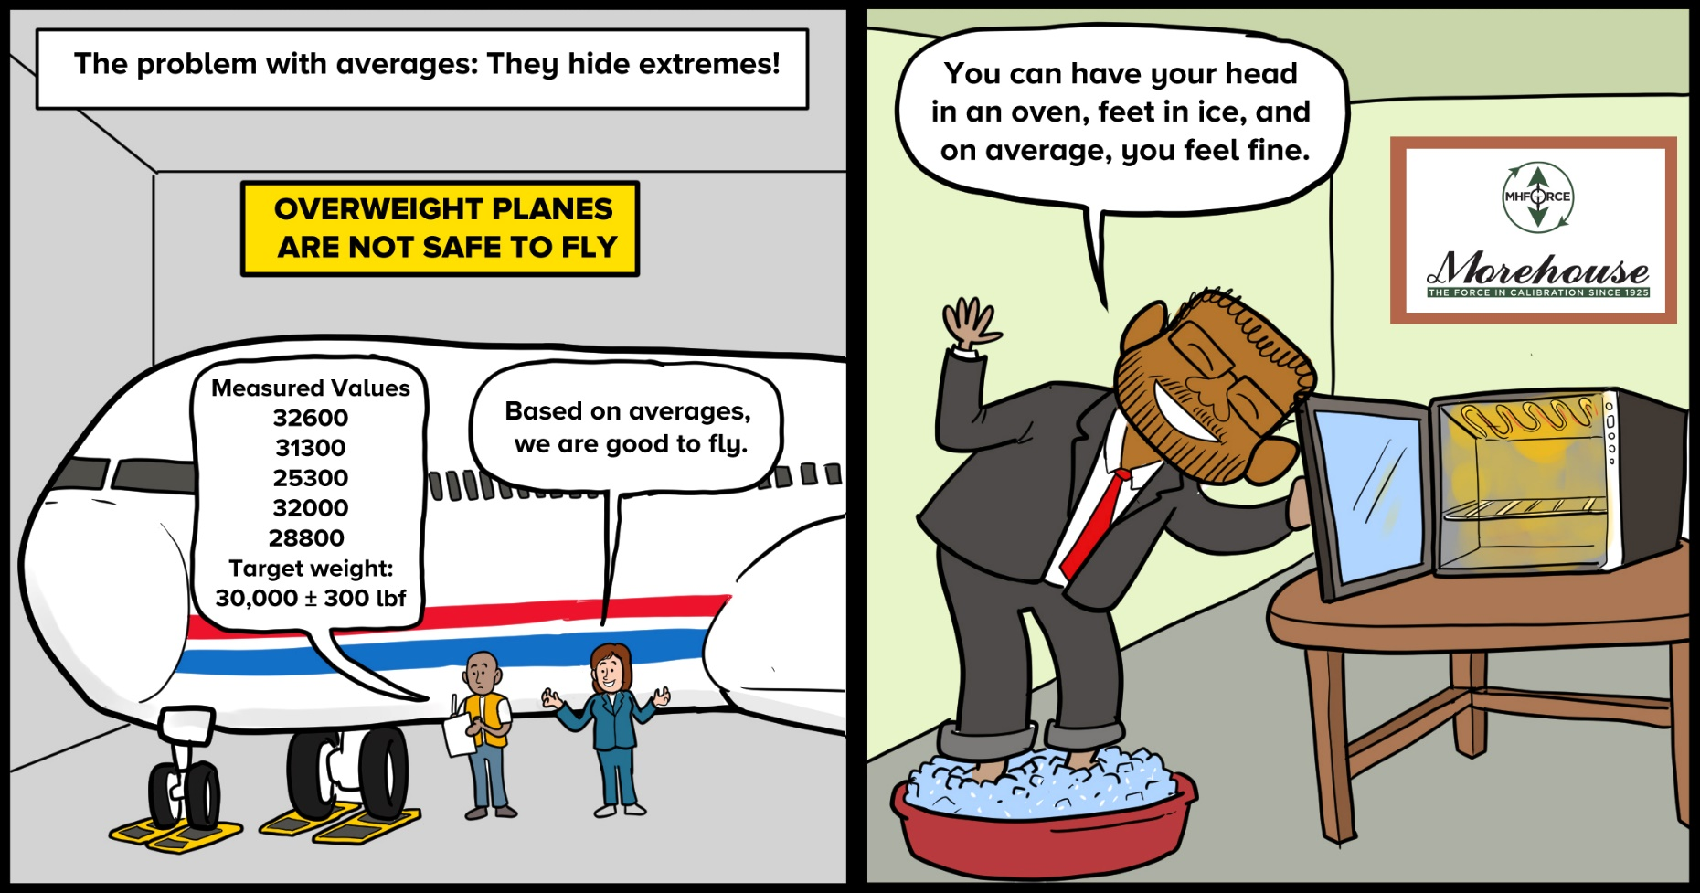
The Problem with Averages

Slide 31
The Problem with Averages

Slide 32
Measurement Decision Rules
7.8.6 Reporting statements of conformity
7.8.6.1 When a statement of conformity to a specification or standard is provided, the laboratory shall document the decision rule employed, taking into account the level of risk (such as false accept and false reject and statistical assumptions) associated with the decision rule employed, and apply the decision rule.
NOTE Where the decision rule is prescribed by the customer, regulations or normative documents, a further consideration of the level of risk is not necessary.
7.8.6.2 The laboratory shall report on the statement of conformity, such that the statement clearly identifies:
a) to which results the statement of conformity applies;
b) which specifications, standards or parts thereof are met or not met;
c) the decision rule applied (unless it is inherent in the requested specification or standard).
NOTE For further information, see ISO/IEC Guide 98-4.

Slide 33
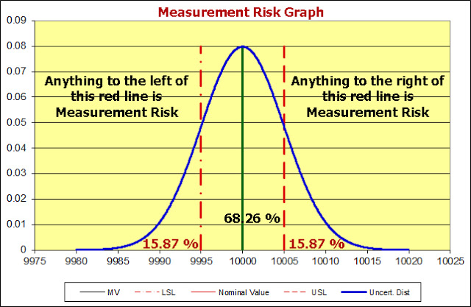
Measurement Decision Risk
Specific Risk Example
ISO/IEC 17025: 2017 Section 3.7 defines a decision rule as a rule that describes how measurement uncertainty is accounted for when stating conformity with a specified requirement.
Notes:
JCGM 106 with

Slide 34
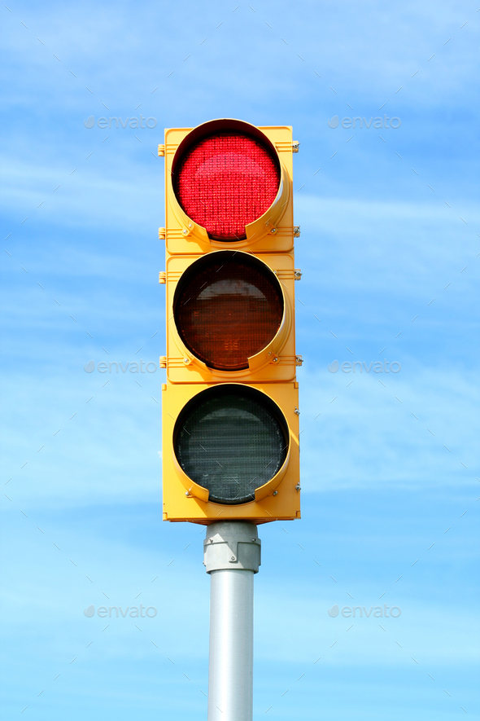
A calibration laboratory cannot make a statement of conformity or "Pass" an instrument without violating ISO/IEC 17025:2017, as section 3.7 defines a Decision Rule as a rule that describes how measurement uncertainty is accounted for when stating conformity with a specified requirement. Some may argue that you can take it into account by ignoring it.
To that end, can we all decide to take all red stoplights into account and start ignoring them?
- UKAS LAB 48 Decision Rules and Statements of Conformity
Notes:
UKAS LAB 48

Slide 35
Types of Risk (Errors)
Type I - Type II Error
 |  | Calibration
 |  | In Tolerance (GOOD) | Out Of Tolerance (BAD)
Decision | Called In Tolerance - ACCEPT | (1-α) Calibration Lab's Confidence (Probability of Correct Accept - PCA) | β Type II Error (Probability of False Accept - PFA)
Made | Called Out of Tolerance - REJECT | α Type I Error (Probability of False Reject - PFR) | (1- β) End User's Confidence (Probability of Correct Reject - PCR)

Slide 36
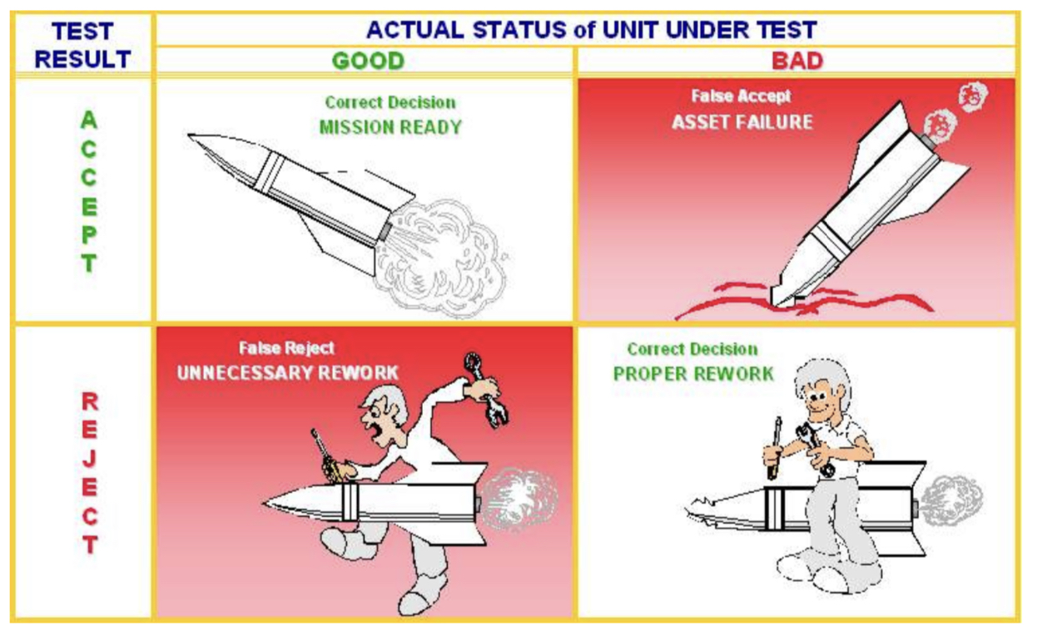
Types of Risk (Errors)
Image from NAVSEA (asq711.org)

Slide 37
Consumer and Producer Risk
There are two general types of risks associated with conformity decisions.
Consumer Risk:
The probability that a non-conforming item is accepted. Also known as Type II error, pass error, false accept risk (FAR), and probability of false acceptance (PFA).
Producer Risk:
The probability that a conforming item is rejected. Also known as Type I error, fail error, false reject risk (FRR), and probability of false reject (PFR).
Consumer risk can have potential negative impacts to product/system performance.
Producer risk has a direct impact on the cost of manufacturing, testing and/or calibration.

Slide 38
Consumer and Producer Risk
Consumer Risk, depending on the criticality of the measurement, can lead to:
  Loss of life or mission
  Reduced end-item function, capacity, or utility
  Warranty expenses
  Damage to corporate reputation
  Loss of future sales
  Punitive damages
  Legal fees, etc
Producer Risk can result in additional costs because of:
  Unnecessary rework, adjustments, repairs, and retests
  Increased scrap of good product
  Increased frequency of inspections or calibrations
  Decreased availability of the hardware
  Out-of-tolerance reports or administrative reaction (reverse traceability reports)
Both type of risks have a cost impact; however, consumer risk has the larger potential for major negative consequences.

Slide 39
Consumer and Producer Risk
Specific Risk (also called bench-level risk) is based on a specific measurement result.
  It triggers a response based on measurement data gathered at time of test.
  It may be characterized by one or two probability distributions, depending on the method.
  Any representation with only one probability distribution is always a specific risk method.
Global Risk (also called process-level risk) is based on a future measurement result.
  It is used to ensure the acceptability of a documented measurement process.
  It is based on expected or historical information and is usually characterized by two probability distributions.
Nominal
Measurement result with distribution. (specific risk)
Historical, or a-priori, information distribution
- L
+ L

Slide 40
Consumer Risk (aka PFA)
Consumer Risk could be altered by fine-tuning of calibration system control tools like:
• Measurement reliability
• Calibration intervals
• Calibration process uncertainty
• Calibration adjustments
• Guard-bands
From: Guard-banding Methods-An Overview

Slide 41
Common Definitions ILAC G8
Tolerance Limit (TL) (Specification Limit) specified upper or lower bound of permissible values of a property.
Measured Quantity Value quantity value represents a measured result.
Acceptance Limit (AL) specified upper or lower bound of permissible measured quantity values.
  LSL – Lower Specification Limit
  USL – Upper Specification Limit
Guard Band (w) interval between a tolerance limit and a corresponding acceptance limit where length 𝑤=|𝑇𝐿−𝐴𝐿|.
Decision Rule that describes how measurement uncertainty is accounted for when stating conformity with a specified requirement. (ISO/IEC 17025:2017 3.7 a rule that describes how measurement uncertainty will be accounted for when stating conformity with a specified requirement).
Test Uncertainty Ratio (TUR) the ratio of the tolerance, TL, of a measurement quantity divided by the 95% expanded measurement uncertainty of the measurement process where 𝑇𝑈𝑅=𝑇𝐿/𝑈.
Notes:
What is MU? What does it Include?
What if someone wants us to make a statement of conformity?

Slide 42
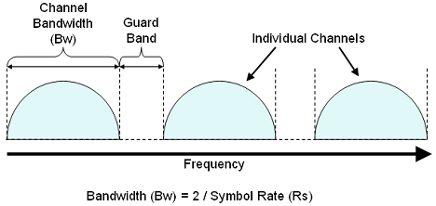
Guard Banding
Notes:
The term “Guard Band,” or sometimes “Guard Band,” appears to have its origins in early radio days when the band of frequencies expected to be utilized by two radio channels or stations were separated by a band of frequency that served to guard against mutual interference by the two channels.
Also, a Guard Band may be applied to increase or widen a tolerance to reduce the false reject risk for
declaring an item to be out-of-tolerance. This is sometimes used to improve the accuracy of the reported
out-of-tolerance conditions where the information is used to monitor the measurement reliability of a
measurement quantity and adjust the calibration interval to achieve stated requirements.

Slide 43
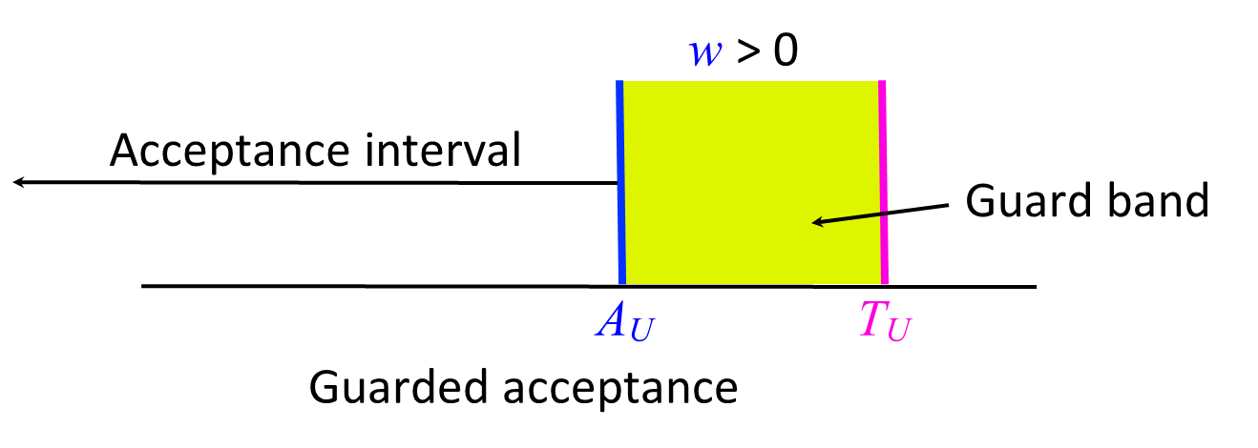

Instrument Measurement Uncertainty Guard Banding
Notes:
Consider Slide 175 images

Slide 44
Types of Risk Scenarios
ASME B89.7.4.1-2005 describes both risk levels well
Specific Risk mitigation can be thought of as “controlling the quality of the workpieces,” while Program Level Risk strategies are described as “controlling the average quality of workpieces.”
Specific Risk being instantaneous liability at the time of the measurement and program level is more about the average probability that incorrect acceptance decisions will be made based on historical data

Slide 45
Specific Risk
Specific Risk (sometimes called bench-level risk) is based on a specific measurement result.
It triggers a response based on measurement data gathered at the time of the test.
It may be characterized by one or two probability distributions, depending on the method.
Any representation with only one probability distribution is always a specific risk method.
Specific risk is after a measurement is made and Global risk is for future measurements
Notes:
Consider adding Slide 139

Slide 46
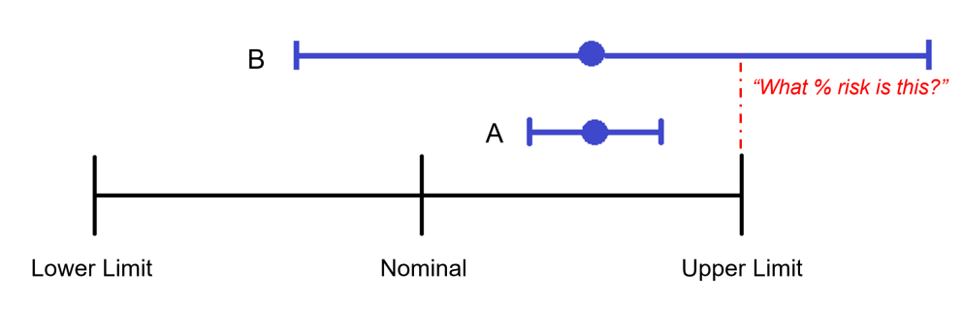
Statement of Conformity
When performing a measurement and subsequently making a statement of conformity, for example, in or out-of-tolerance to the manufacturer’s specifications or Pass/Fail to a particular requirement, there are two possible outcomes:
The result is reported as conforming with the specification
The result is reported as not conforming with the specification
Illustration of Measurement Decision Risk

Slide 47
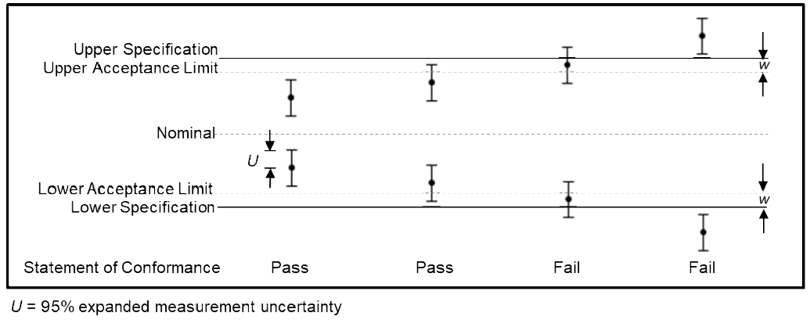
Binary Statement with Guard Band
Notes:
W is the Guard Band

Slide 48
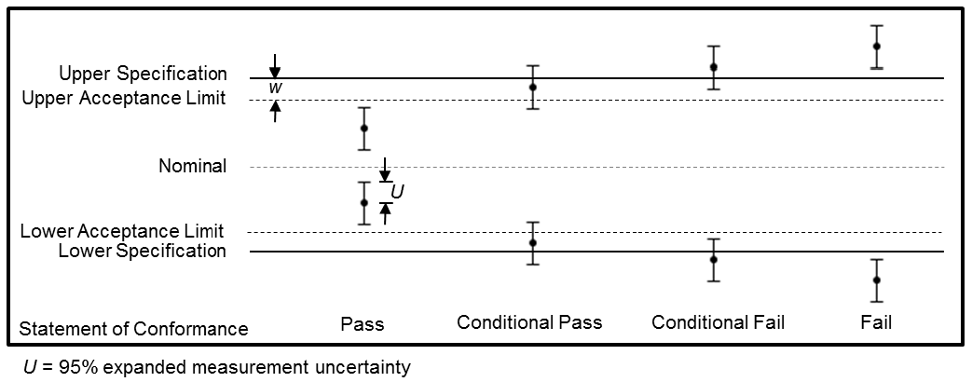
Non-Binary Statement with Guard Band

Slide 49
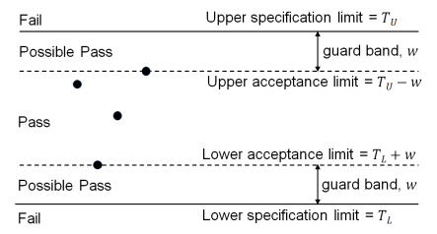
Non-Binary Statement with Guard Band
Example from UKAS LAB 48

Slide 50
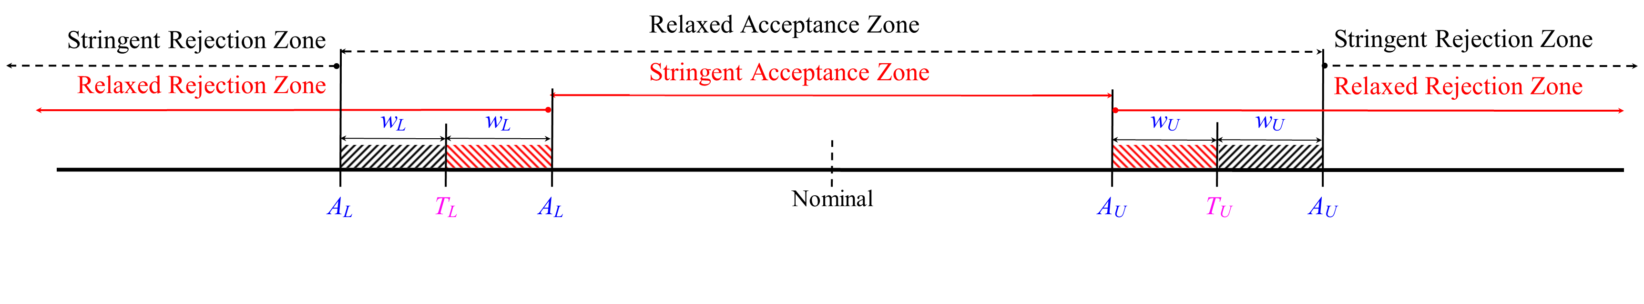
ASME B89.7.3.1-2001 – Specific Risk

Slide 51
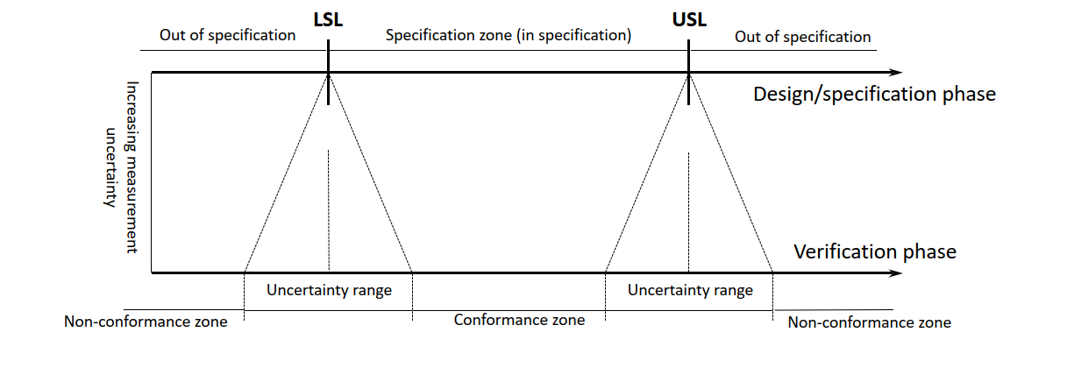
The Size of Acceptance limits is Determined by the Measurement Uncertainty and Desired Risk Level.
ISO 14253-1:2017

Slide 52




Classic 50 % risk scenario with “Simple Acceptance” at the bench level (w = 0), No Guard Band.
50 % of our distribution is over the Upper Specification Limit

Slide 53
Instrument Measurement Uncertainty
Guard Banding at bench-level (w = r * U₉₅ )
Guard Band of w = 0.09305 (99 % Probability of Conformance) MV = 1500.1069
Notes:
Break and go use the Spreadsheet

Slide 54

Star Wars Example
With a 2-meter hole and a 0.5-meter Photon Torpedo.
What would be the acceptance limits using a specific risk example?

Slide 55
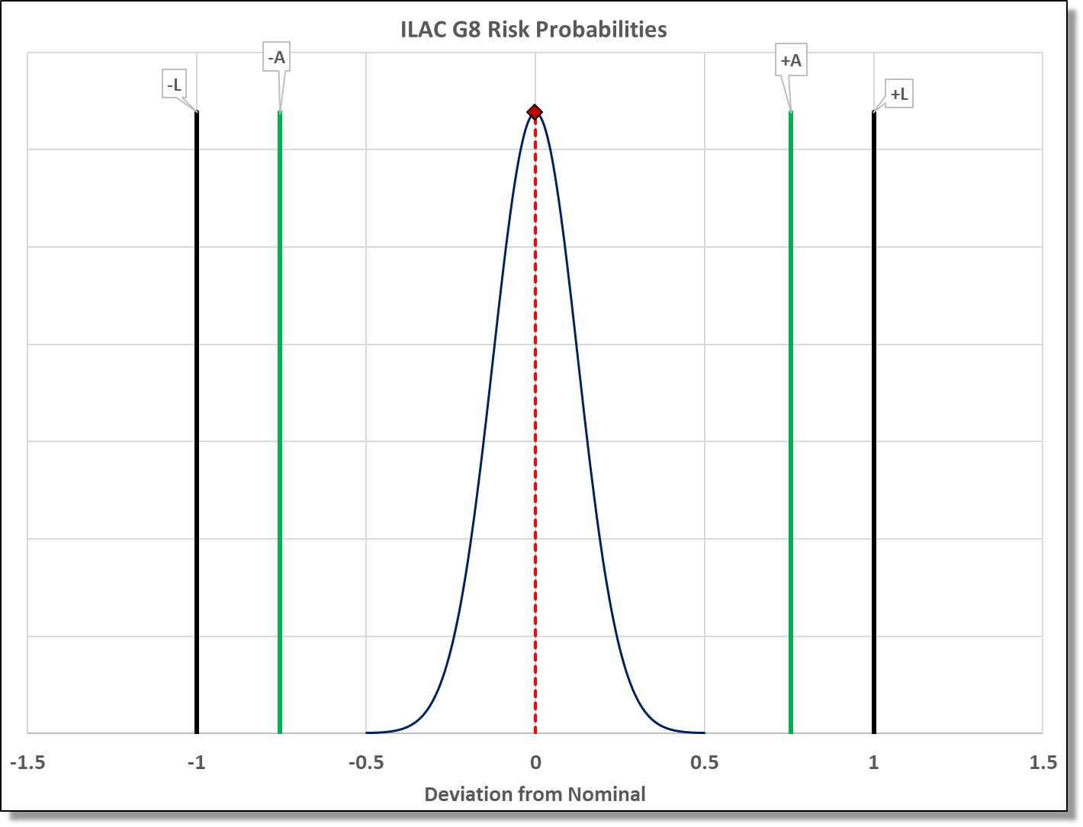

Star Wars Example – AL for 2.5 % Maximum risk
Vent Port

Slide 56
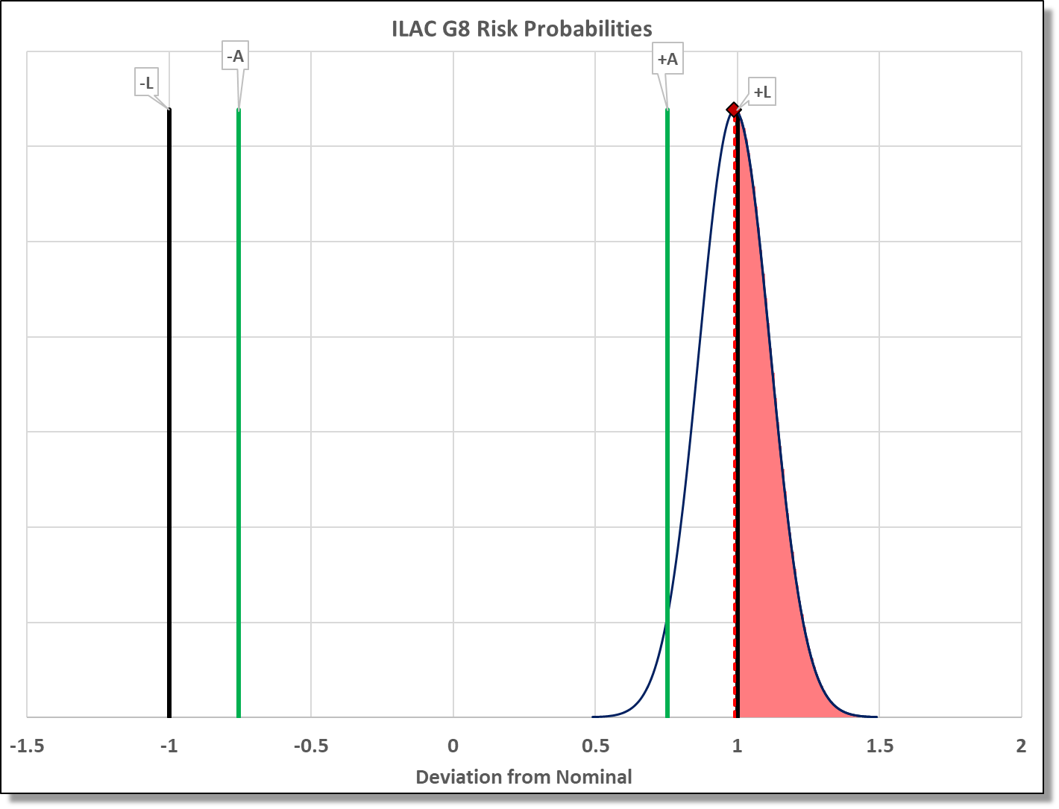
Star Wars Example – Measured Value not Centered
Vent Port

Slide 57
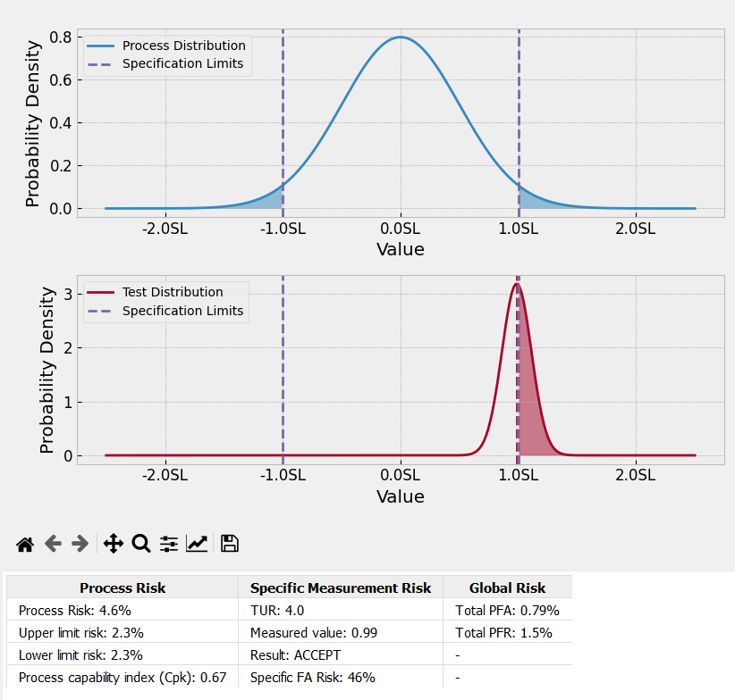
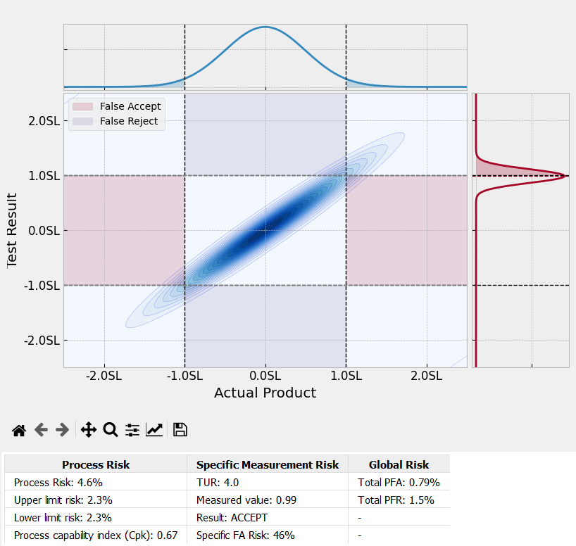
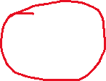
Star Wars Example
Vent Port
Notes:
CpK and the location of the measurement can matter.

Slide 58
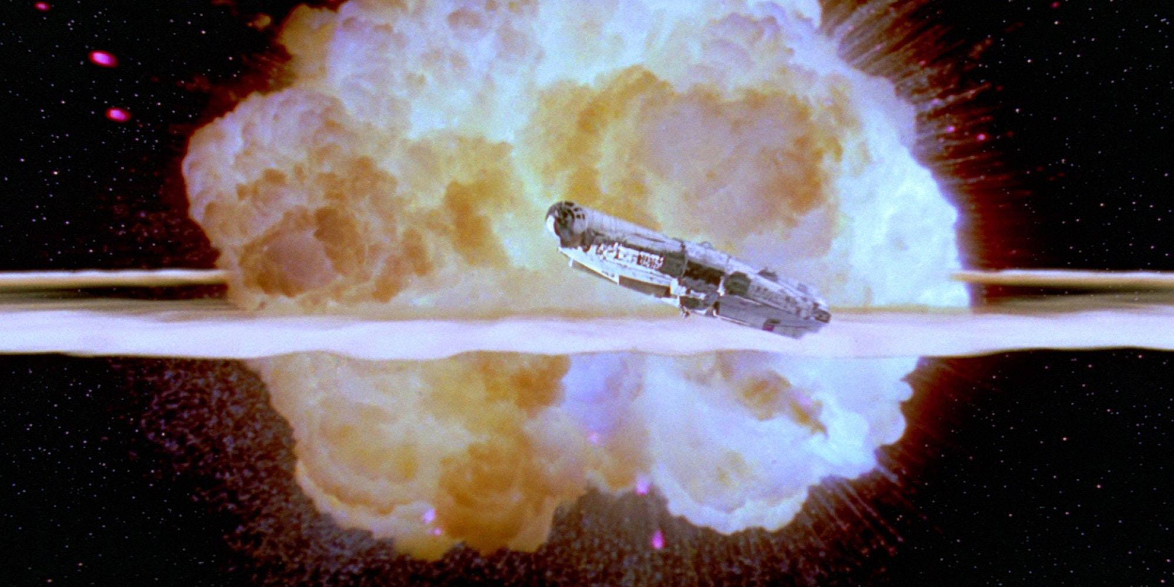
Notes:
And we know what happened

Slide 59
Global Risk
Global Risk (also called process-level risk) is based on a future measurement result.
It is used to ensure the acceptability of a documented measurement process.
It is based on expected or historical information and is usually characterized by two probability distributions.
The term TUR (Test Uncertainty Ratio) is commonly used as a simplified approach to evaluating global risk. When we know the tolerance, we are working to, we have a high enough sample size to know the shape and the distribution of the calibration results.
We can then use TUR with End of Period reliability, or even by itself, to calculate the appropriate uncertainty that corresponds to the maximum amount of false accept risk we are okay with.

Slide 60
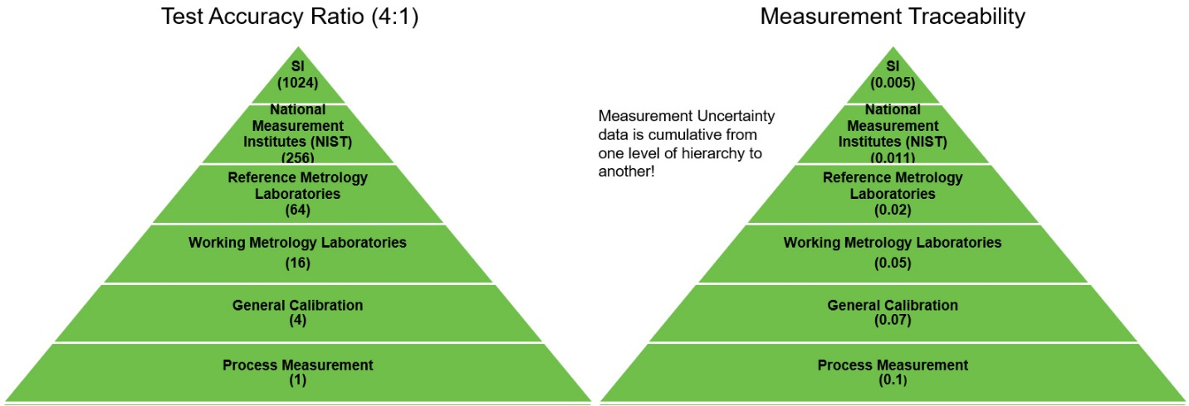
Outdated Practices Can Lead to Higher Risk
In Measurement Decision Risk – The Importance of Definitions, Scott M. Mimbs provides an example of a digital micrometer using a TAR 25:1 ratio. Comparing this example with the definition of TUR found in the ANSI/NCSL Z540.3 Handbook produces a 1.5:1 ratio for the same measurement.
Notes:
Is this sustainable?

Slide 61
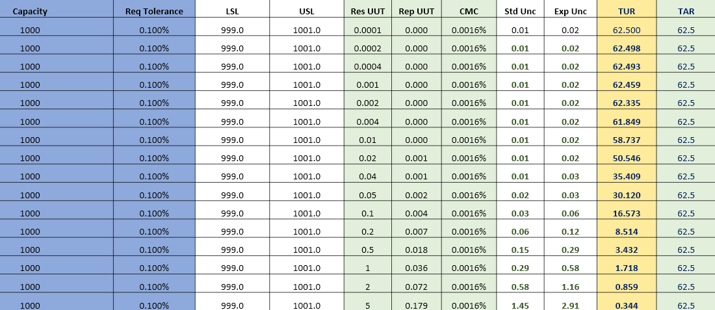
Outdated Practices Lead to Higher Risk
In this table we are only varying resolution and repeatability of the UUT.
Notes:
This slide shows the differences between TAR and TUR calculations

Slide 62
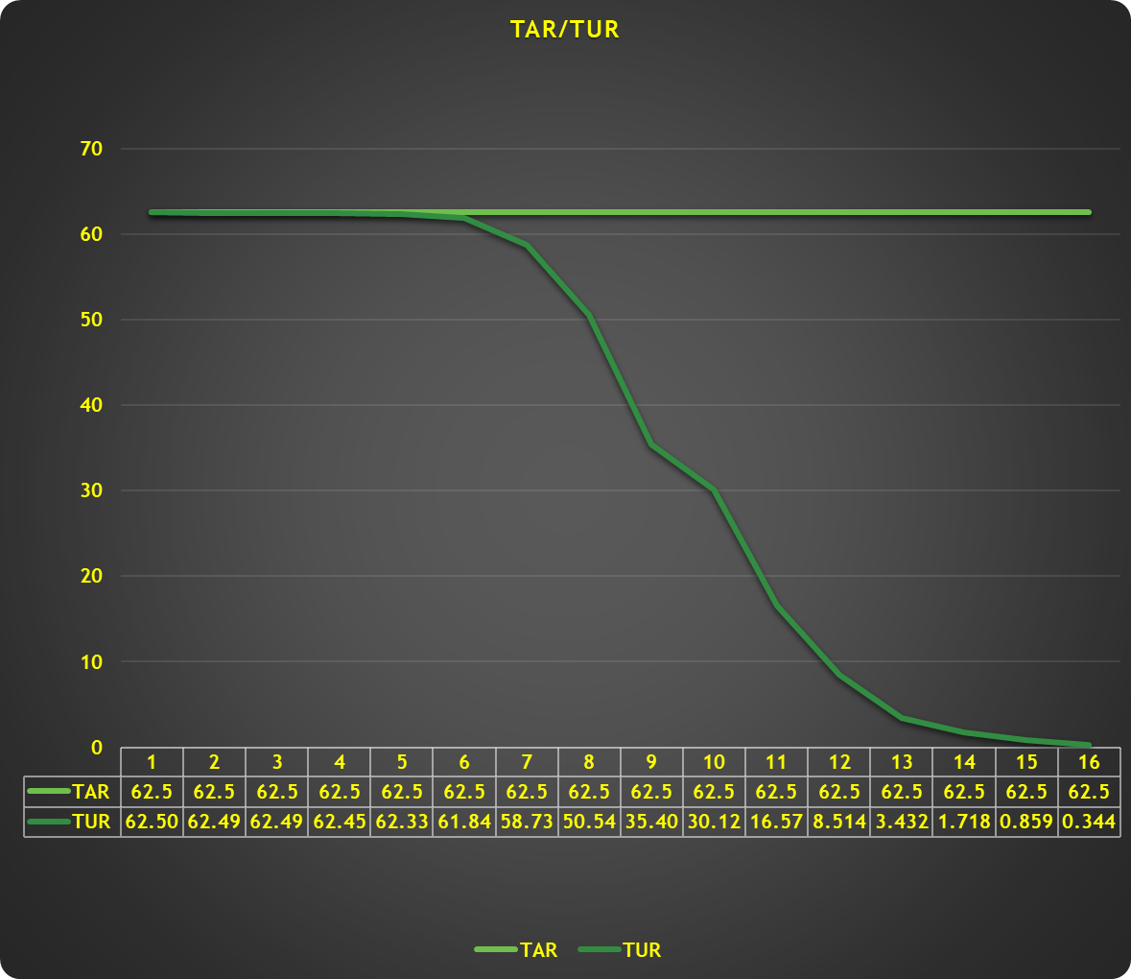
Notes:
Is this sustainable?

Slide 63
Test Uncertainty Ratio (TUR)
Test Uncertainty Ratio: The ratio of the span of the tolerance of a measurement quantity subject to calibration to twice the 95% expanded uncertainty of the measurement process used for calibration.
  NOTE: This applies to two-sided tolerances.
  ANSI/NCSL Z540.3 – 2006 Definition
  UUT – Unit Under Test
Notes:
TUR originated in the Navy’s Production Quality Division during the 1950’s in an attempt to minimize incorrect acceptance decisions.

Slide 64
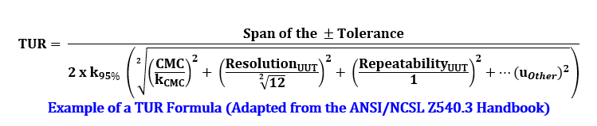
The Correct Definition and Calculation of TUR
In most cases, the numerator is the UUT Accuracy Tolerance. The denominator is slightly more complicated. Per the ANSI/NCSL Z540.3 Handbook, "For the denominator, the 95 % expanded uncertainty of the measurement process used for calibration following the calibration procedure is to be used to calculate TUR. The value of this uncertainty estimate should reflect the results that are reasonably expected from the use of the approved procedure to calibrate the M&TE. Therefore, the estimate includes all components of error that influence the calibration measurement results, which would also include the influences of the item being calibrated except for the bias of the M&TE. The calibration process error, therefore, includes temporary and non-correctable influences incurred during the calibration such as repeatability, resolution, error in the measurement source, operator error, error in correction factors, environmental influences, etc."

Slide 65
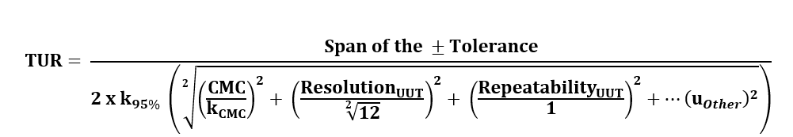
TUR (Test Uncertainty Ratio)
UUT Tolerance = (USL-LSL)/2
CMC = Reference labs Calibration and Measurement Capability
k = coverage factor
ANSI/NCSL Z540.3 Handbook Definition

Slide 66

The lab with the smaller uncertainties will typically produce larger TURs, giving you more space to be in tolerance!

Slide 67

The lab with the larger uncertainties will typically produce smaller TURs, giving you less space to be in tolerance!

Slide 68

EOPR
In simplistic terms, End of Period Reliability is defined as the number of calibrations resulting in acceptance criteria being met divided by the total number of calibrations. This formula to determine "In-Tolerance" Reliability from historical data is easy to replicate in Excel. The formula is Sample Size = ln(1-Confidence)/ln(Target Reliability)
If we use the formula for Sample Size above, we will need over 59 (58.4) samples to use a joint probability distribution associated with many TUR-based methods.
There is more with EOPR as the rules to establish EOPR can be subjective. Things such as how many first-time calibrations are counted, broken instruments included, are calibrations with different due dates, or calibrations that are extended included, what about post-dating, and so on.

Slide 69
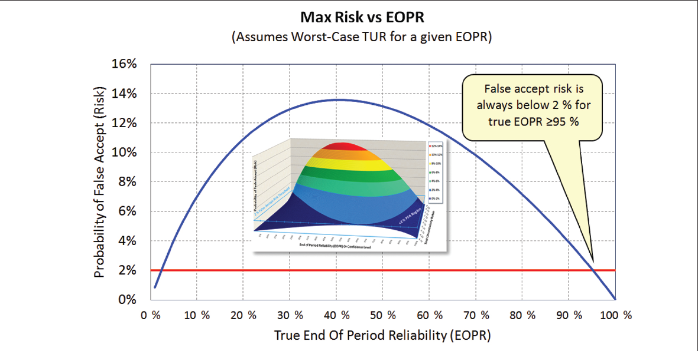
EOPR
From Risk Mitigation Strategies for Compliance Testing by Jonathan Harben and Paul Reese

Slide 70
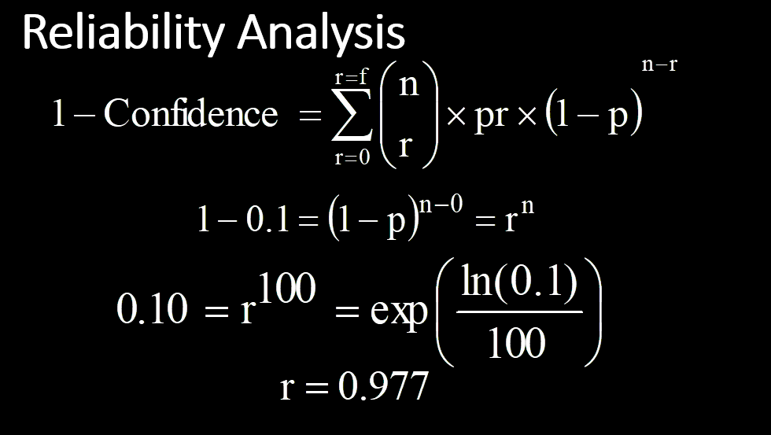
EOPR
Reliability Considerations may include:
Reliability decreases with time after calibration
How much testing is required to demonstrate reliability with confidence?
A priori knowledge of the M&TE
Reliability Analysis of M&TE should be based on similar instrumentation manufacture, model #, calibration intervals. What should be avoided is intermixing different M&TE with different calibration intervals.
Note: the interval is the estimate, that is, 0.977 is not a reliability estimate, but merely a lower bound of a confidence interval estimate
Notes:
LM-1 notes and

Slide 71
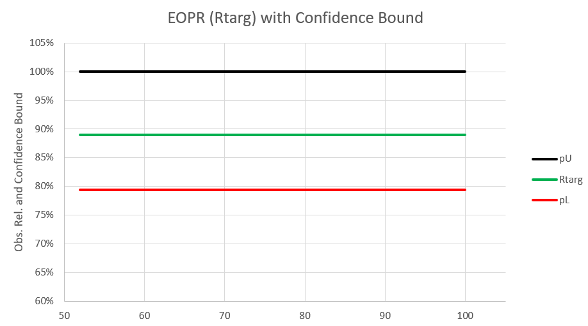
EOPR
When trying for a particular EOPR at a specific confidence interval, what you are doing is creating a tolerance around your EOPR.
So, for 89 % EOPR at 95 % confidence with 26 samples, the (conservative) EOPR is ~89 % (89 % to 100 %). One should always take the calculated lower binomial bound as the worst case EOPR.
But for the same EOPR with only 13 samples, EOPR is 79.42 % (79 % to 100 % as shown above)
Notes:
Reliability Conclusion
Calculating Reliability alone may not be enough to ensure confidence in your measurement.
Calculating Confidence Intervals correctly will give insight into your actual reliability.
Typically, many labs struggle with getting enough samples. In which case, it is important to make sure the lab performing the calibrations has low enough measurement uncertainty to reliably pass the M&TE.
The calibration intervals are set based on end of period reliability and should be shortened if they do not meet the end user reliability target.

Slide 72
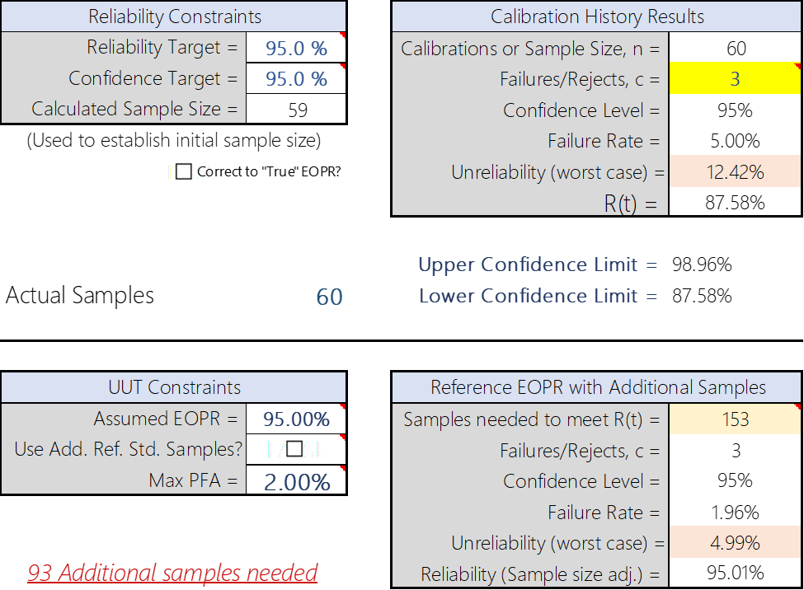
Ref Standard Stability / EOPR
Sample Size = ln(1-Confidence)/ln(Target Reliability).
This is a formula for calculating with enough confidence how many samples one would need to prove a tolerance or say stability from one calibration to the next.
For our example, we needed 59 samples with 0 failures, when that did not happen, we needed more samples.
Notes:
There is more with EOPR as the rules to establish EOPR can be subjective. Things such as how many first-time calibrations are counted, are broken instruments included, are calibrations with different due dates, or calibrations that are extended included, what about post-dating, and so on.

Slide 73
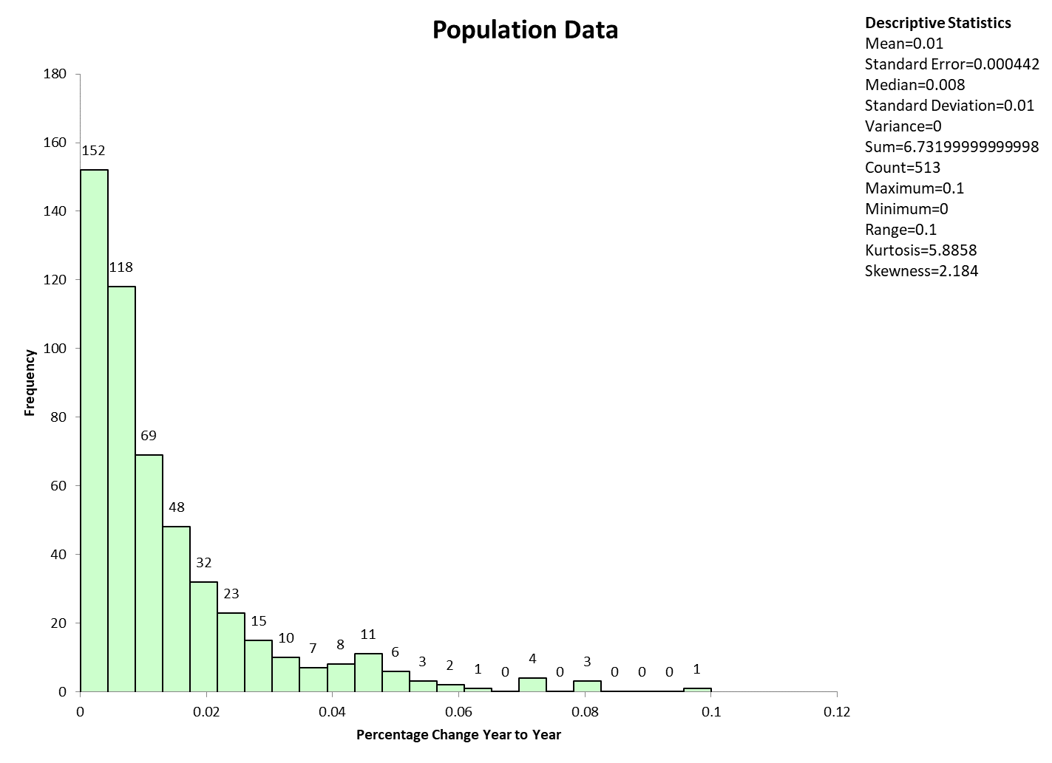
Ref Standard Stability / EOPR
What we found was 171 load cells and sampled the stability criteria at 10 %, 50 %, and 100 % test points with 95.77 % confidence that are population of sampled load cells was better than 0.05 % from year-to-year

Slide 74




Basics – The Quality of the Measurement System
A method for characterizing the quality of a measurement system relative to a specific tolerance to be measured is defined in three documents.
  JCGM 106:2012 defines the measurement capability index (C_{m})
  ASME B89.7.4.1-2005 uses the same definition for C_{m}
  ANSI/NCSL Z540.3-2006 redefines the test uncertainty ratio (TUR) with respect to the GUM
The C_{m} and TUR are useful indicators of the quality of the measurement system (i.e., large C_{m} or TUR is indicative of low measurement uncertainty compared with the tolerance).
As defined in the references, C_{m} and TUR are mathematically identical; however, there is a possibility that TUR could be confused with an older, less rigorous definition.
Therefore, we favor the measurement capability index (C_{m}).
$$C_{m}=\frac{T_{U}−T_{L}}{4⋅u_{m}}=\frac{T_{U}−T_{L}}{2⋅U_{95}}$$
$$TUR=\frac{L_{upper}−L_{lower}}{2⋅U_{95}}$$
$$U_{95}=k⋅u_{m}$$
$$k=1.96≈2$$

Slide 75
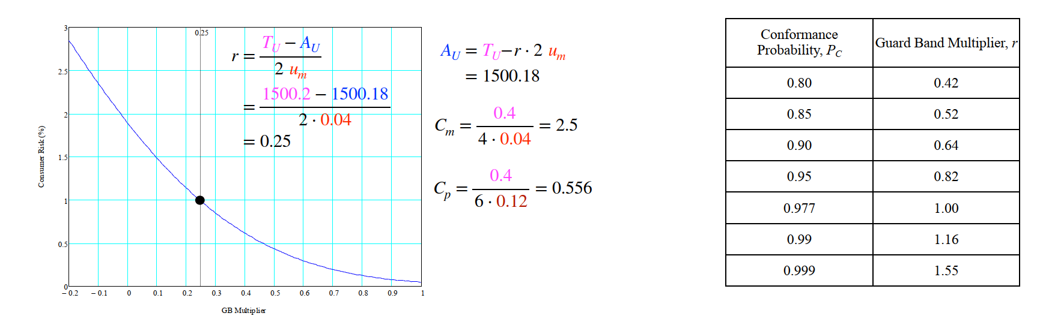
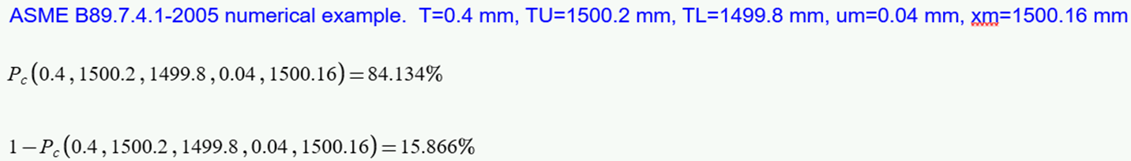
Setting acceptance limits for Global Risk is more complex, requiring iterative numerical integration to ﬁnd the acceptance limits for a desired level of risk. Many times, graphical solutions can be used to set the acceptance limits.
Guard Band Multiplier, r = Norm.s.inv(0.6827)/2 = 0.2376
Notes:
Cm Measurement Capability Index
Cp, or capability potential, is a measure of the potential capability with the assumption that the distribution of the sample process data is normally distributed and centered within the customer's upper specification limit and lower specification limit.
Cp = 0.12 which is is 3 x MU = 6 sigma times process uncertainty = 3 sigma x 0.04 = 0.12
In this example we think r is calculated at 1 sigma
Guard Band Multiplier, r = Norm.s.inv(0.8)/2
Solution. From Table 2, with PC p 0.99, we see that
h p 1.16. Thus, the Guard Band limits should be set
inside the tolerance limits by 116% of the expanded
uncertainty. Then the upper gauging limit is
GU p TU − hU
p 1 500.2 mm − 1.16 0.08 mm
≈ 1 500.1 mm
and the lower gauging limit is
GL p TL + hU
p 1 499.8 mm + 1.16 0.08 mm
≈ 1 499.9 mm

Slide 76
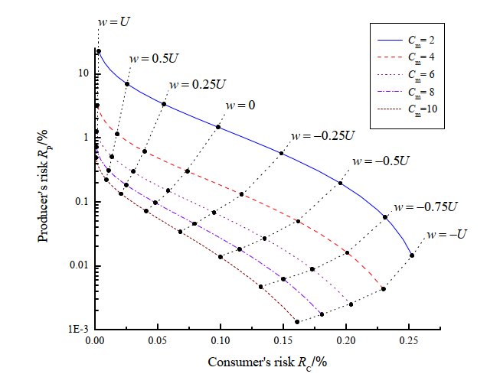
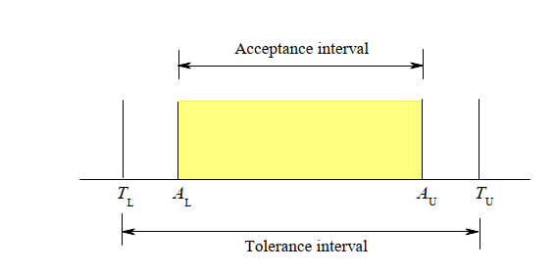
Global Risk
Global risks RP versus RC for a binary conformity assessment with prior standard uncertainty u0 = T/6. The ﬁve curves correspond to values of the measurement capability index Cm = T/(4um) in an interval from 2 to 10. The solid points locate Guard Bands with length parameters from w = −U to w = U, with U = 2u. Positive values of w correspond to guarded acceptance, with acceptance limits inside the tolerance limits as shown left.

Slide 77
Global Risk
Scott Mimbs wrote a paper on EOPR at 89 % and how the 2 % PFA rule could be met by analyzing a population of instruments with years of history.
If one cannot gather all of the information, then further analysis would be needed, and TUR must be determined at each test point. If the analysis reveals the TUR is greater than 4.6:1, then the PFA will be less than 2 %. (From Risk Mitigation Strategies for Compliance Testing)
If neither the EOPR nor TUR threshold is met, one could choose to use Specific Risk methods or use another method.
Notes:
This assume the process is centered

Slide 78
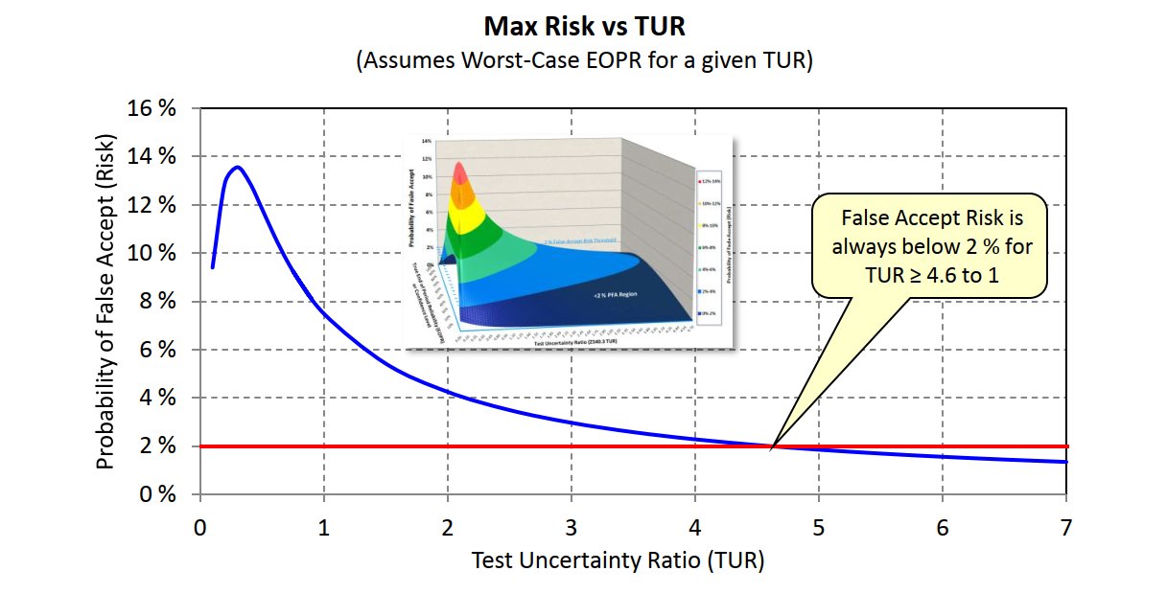
Global Risk
The image is taken from Implementing Strategies for Risk Mitigation In the Modern Calibration Laboratory
Notes:
This assume the process is centered
From Risk Mitigation Strategies for Compliance Testing

Slide 79

Global Risk
We want to build an army of clones to defeat the Rebellion.
The optimum height is 70 inches ± 2 inches to fit our clones with the same gear and maximize cloning efficiencies.
Our measurement system has a TUR of 8:1 meaning our Calibration Process Uncertainty is 0.25 inches.
The question becomes what is the probability of saying a clone conforms to the specification when it does not?

Slide 80


Global Risk
Notes:
0.0039 % or 3.9 per million are expected to be said to be in conformance when they are not. This means 1 out of every 500,000 will be too short

Slide 81


Global Risk
Notes:
And that is why this one out of approximately 500,000 clones will hit their head on our entryway

Slide 82
Global vs Specific Risk Example
A company has hired us to measure the speed of cars on a stretch of a single-lane road.
The customer has indicated they are okay with 57 -63 miles per hour (MPH) speeds.
Thus, our specification limit is based on 60 MPH ± 3 MPH. The posted speed limit is 60 MPH.
After much discussion, we decided to set up two radar guns at points A and B for the first day and report the results. (Example of Specific Risk is based on measuring individual speeds at point A or point B)

Slide 83


Specific Risk
Specific Risk
65 mph
Specific Risk
55 mph
OR
If we wanted to look at the car's speed using Specific Risk, we might have a radar gun at either points A or B. In this example, the car is clocked at 65 mph at point A and 55 MPH at point B. Each point is 5 MPH below or above the speed limit.
Note: Using the average of these two would be considered a global risk while taking just one is a specific risk.
Notes:
If we wanted to look at the car's speed using Specific Risk, we might have a radar gun at Points A and B. In this example, the car is clocked at 65 mph at point A and 55 MPH at point B. Each point is 5 MPH below or above the speed limit.

Slide 84
Specific Risk (Radar Gun at Point A)
Risk Calculator
Upper Tolerance T_{U} | 63.0000
Lower Tolerance T_{L} | 57.0000
Nominal Value | 60.0000
Measurement Unc um | 0.2500
Measured Value xm | 65.0000
Tolerance T | 6.00
Probability of Conformance (p_{c}) | 0.000%
Probability of NonConformance (1 - p_{c}) | 100.000%
Setting the Guard Band Upper and Lower p_{c}
Select Desired Conformance Probability | 0.977
Guard Band Upper G_{u} | 62.5000
Guard Band Lower G_{L} | 57.5000
Specific Risk (Bench-Level)
Conditional Probability False Accept | 100.000%
Conditional Probability False Reject | 0.000%
5 MPH Above (TUR 6:1)

Slide 85
Specific Risk (Radar Gun at Point B)
5 MPH Above (TUR 6:1)

Slide 86
Global Risk
65 mph
55 mph
Global Risk: The average speed is 60 mph.
The car enters point A, traveling at 65 MPH, and then 0.5 miles into the drive, travels at 55 MPH.
Global risk is based on measuring the average speed once a reliability target has been met (we took 10,000 data points and found 98 % to be good).
Notes:
The car enters point A, traveling at 65 MPH, and then 0.5 miles into the drive, travels at 55 MPH. When we take our reading, the stopwatch reads 1 minute. Global risk is based on measuring the average speed once a reliability target has been met (we took 10,000 data points and found 98 % to be good/conforming). This is one of the 2 % that are not conforming

Slide 87
Global Risk and Specific
Specific Risk
65 mph
Specific Risk
55 mph
Global Risk: The average speed is 60 mph.
Global Risk - According to our data, about 1 % of drivers will drive over 63 MPH and 1 % below 57 MPH. We may not know the specific speeds at points A and B, though we will know the average speed on the mile stretch of road. – This might be good enough for what we want to measure.
Notes:
Global Risk - According to our data, about 1 % of drivers will drive over 63 MPH and 1 % below 57 MPH. We may not know the specific speeds at points A and B, though we will know the average speed on the mile stretch of road. – This might be good enough for what we want to measure.

Slide 88

Global Risk Results
On Day 1, we recorded about 10,000 vehicles. Out of the 10,000 vehicles, 9,800, or 98 %, are observed to be driving between 57 – 63 MPH.
In our example, Global Risk is found by using 2 Radar Guns and taking the average

Slide 89

Global Risk
60 seconds = 60 MPH
Global Risk: The average speed is 60 mph.
Since two radar guns are very good (high TUR), though expensive, maybe we consider a method that is less expensive, maybe an automated time-based method.
With a less accurate method our TUR might be 3:1 or half as good. What would this look like?
Notes:
Global Risk - According to our data, about 1 % of drivers will drive over 63 MPH and 1 % below 57 MPH. We may not know the specific speeds at points A and B, though we will know the average speed on the mile stretch of road. – This might be good enough for what we want to measure.

Slide 90

Global
Global Risk – Using a less accurate means of measuring (A process with a higher measurement uncertainty)
Notes:
Now our PFA is 2 % compared to 0.32 %. Our Process Risk is 13 % with upper and lower limits at 6.7 % instead of 1 %.

Slide 91



Global
Global Risk – What if the data revealed an asymmetrical tolerance, for instance, it is much more likely from being on the roads in Akron that 1 % might be going under 60 mph and 25 % going over the speed limit.

Slide 92
Global Versus Specific Risk Summary
Specific Risk is dependent on a single probability function and can be referred to as Probability of Conformance from the customer’s point of view.
Global Risk is dependent on two probabilities, the second being the a priori knowledge, which could be taken as the process or instrument reliability.
Typically, when we talk about TUR, we are talking about Global Risk.
Though TUR is also a ratio that can be useful at the Specific Risk level as higher TURs increase our acceptance zone.

Slide 93

Example – Radar Gun
EXAMPLE 1 Speed limit enforcement
Highway law enforcement gets wind of 25 % of the cars speeding ☺
The speed of motorists is measured by police using devices such as radars and laser guns. A decision to issue a speeding ticket, which may potentially lead to an appearance in court, must be made with a high degree of Confidence that the speed limit has been exceeded.
If we know that we can only win a court case if there is a 99.9 % probability that our speed limit has been exceeded, when can we write a ticket?

Slide 94

Example – Radar Gun
The Speed Limit is 60 mph with an
um of 2 %
um = 0.02
Probability = 99.9 %
TU = 60
What is Vmax or the speed someone has to be going to receive a speeding ticket with 99.9 % probability of actually speeding?
Vmax = TU / 1 – 0.02 z
ANSWER?
=NORMSINV(Probability)/1
Vmax = 60 / 1 -0.02 (3.090) = 63.953 mph
What about 75 mph?
Vmax = 75 / 1 -0.02 (3.090) = 79.94 mph
Notes:
This is an example of guarded rejection

Slide 95
Overall review with Examples
Global Risk
Resistor Manufacturing – Based on in-tolerance probability (itp), within binomial confidence bound, utilizing appropriate reference standards
As more items are manufactured, the binomial confidence bound reflects the uncertainty of the itp
This method relies on the bivariate (2 variables) Gaussian joint probability distribution function, the UUT (in this case a fixed resistor), and the measurement system is assumed to be a high speed DMM
Specific Risk
Resistor Measurement - anything failing the test tolerance in the manufacturing process, may be segregated and subject to additional scrutiny
If meager information is provided (such as a prototype), or the risk of passing a potentially bad item is high, a more conservative approach would utilize specific risk

Slide 96

Testing Cost Associated - specific risk versus global
Often, choosing the correct equipment for a specific task is an afterthought. Let’s start with a simple example of verifying a manufactured fixed-value resistor
The fixed value is 1,500 ohms ±0.2 ohms (±~0.013…3%). The original idea is to manufacture these items as inexpensively as possible
After some quick research, based on brand recognition, a choice is made to purchase a Keysight 34470A DMM as it “seems” to fit the situation due to the exception resolution of 7 ½ digits and it doesn’t break the budget as the list cost is ~$4,405
The TUR being ~1.44:1 – the process owner felt this was adequate because a simple global GB tolerance of ±0.122 (in lieu of ±0.2) is in place for pass/fail criteria and it was assumed the process would be centered around a nominal value of 1,500 ohms. This would give the PFA a global risk of ~1%
With the process assumed centered around 1,500 ohms, this calculates to an itp of ~99.93% for specific risk (~1.2% global risk … “close enough” comes to mind)
But then, during the production process, something happens …

Slide 97
Testing Cost Associated - specific risk versus global
During preliminary production runs, it was discovered ~30% of all products manufactured failed global GB tolerance testing of ±0.12Ω
An investigation is launched to verify the rejected items are truly OOT. This is accomplished by sending failed samples to the metrology lab for verification
The metrology lab retested the reportedly failed products and discovered less than 0.2% were true failures
How can this happen?
Globally, the conformance tolerance may be Guard Banded at ±0.12Ω but, for it to pass using specific risk, that same test tolerance must be reduced to ±0.039Ω leaving virtually no room for any deviations from the nominal value
The global risk tolerance must be reduced by ~40% while the specific risk tolerance reduced by >80%!

Slide 98


Testing Cost Associated - specific risk versus global
The better solution is a more accurate DMM but at what cost?
We already know the 34470A isn’t ideal, however the cost of a Fluke 8558A >3x the expense but more accurate. Will it work?

Slide 99
Testing Cost Associated - specific risk versus global
Yes!, it will work. The expected false rejection rate is 1.035% and the consumer risk is <1% (process uncertainties excluded as this is exploratory)
Given the cost of higher quality reference standards, and the associated maintenance, is it cost effective?

Slide 100
Testing Cost Associated - specific risk versus global
Getting back to the question: “Given the cost of higher quality reference standards, and the associated maintenance, is it cost effective?”
The answer is “maybe.” A maybe is a cautiously issued verdict because we don’t know the process uncertainty of our resistor batch. The previous process uncertainty (0.12) was determined using an incorrect reference meter, which was 60% of the total tolerance, therefore additional testing/analysis is required to prove out the concept.

Slide 101

Expected Failure Rates with GB Strategies

Slide 102

TUR’s vs Total Cost due to false rejection & retest

Slide 103
Sample Quiz
What is the Definition of Metrological Traceability?
Metrological Traceability: Property of a measurement result whereby the result can be related to a reference through a documented unbroken chain of calibrations, each contributing to the measurement uncertainty.
Define a Decision Rule?
Decision Rule that describes how measurement uncertainty is accounted for when stating conformity with a specified requirement. (ISO/IEC 17025:2017 3.7 a rule that describes how measurement uncertainty will be accounted for when stating conformity with a specified requirement).

Slide 104
Sample Quiz
Describe the Difference Between Specific Risk and Global Risk
Specific (Bench-Level) Risk mitigation can be thought of as “controlling the quality of the workpieces,” while Program Level (Global) Risk strategies are described as “controlling the average quality of workpieces.”
What is the Measurement Capability Index (TUR) that will limit the Probability of Non-Conformance (FAR) risk to less than 2 %?

Slide 105


“Trust but Verify”
Or as Henry likes to say “Cut Twice, Measure Once” - ☺

Slide 106
What are Some of the Things We Can Control to Mitigate Our Risk?
We can raise our tolerance if we do not need what the manufacturer states.
We can decrease the time between calibrations
Maybe it is a matter of a too coarse resolution where a different indicator would help.
If we want to observe high in-tolerance probability, we will need to have one of these conditions met
An extremely good UUT, and an acceptable Reference Standard, providing a minuscule PFA (e.g., 0.01 %), or
A relatively good UUT, and a good Reference Standard, providing an acceptable PFA (e.g. < 2.0 %)
- S. Mimbs Rule of 89 paper

Slide 107
Accuracy and Precision
This is what we see happening a lot and the reason for this discussion.
A precise instrument with a known Systematic Error
High Precision (Small Random Error)
High Accuracy (Low Bias)
High Precision
Low Accuracy (High Bias)
Low Precision (Large Random Error)
High Accuracy (Low Bias)
Low Precision
Low Accuracy (High Bias)

Slide 108

Instrument Measurement Uncertainty Guard Banding
Nominal Value of 10
Measured Value of 10, No Bias
Nominal Value of 10
Measured Value of 11.75, Bias
Bias
Nominal Value
Nominal Value

Slide 109


Bias – Centered Measurement
Page 92 Section 5.2 Introduction to Statistics in Metrology

Slide 110

Instrument Measurement
+ 9 lbf Bias
+ 9 lbf
Graph Showing 10 009.0 as the measured value with a 58.789:1 TUR, which is achieved by using a lab with low uncertainties (Morehouse actual example) There is a bias of + 9 lbf in this example.

Slide 111
Force Applied | Measurement Value | Offset, Bias ,Systemic Measurement Error
10 000.00 | 10 009.00 | + 9
10 000.00 | 10 009.00 | + 9
When you know the value to generate 10 000.0 N is 10 0009.0 N.
The right thing for the end-user to do is to load the device to 10 009.0 N to apply 10 000.0 N of force.

Slide 112
What Happens When We Do Not Correct the Bias?
Let us assume they do not do that and use this device to calibrate another 10,000 N instrument.
The reference standard is not loaded to 10 009.0 N to apply 10 000.0 N
Notes:
The reference standard is not loaded to 10 009.0 N to apply 10 000.0 N. Instead, the device is loaded to 10 000.0 N, which means only 9 991.0 N is applied (10 000.0 – 9.0 = 9 991.0)
We show not correcting for this +9 N bias graphically by subtracting 9 N (9 996.0 – 9.0 = 9 987.0) from the measured value. The UUT reads 9 987.0 N, which could result in the lab failing the instrument and deciding to adjust the device within the acceptance limits (the measured value of this calibration is now off by 9 N and transferred to the UUT).
The result of not correcting for the +9 N bias is a failed instrument that has been adjusted using a reference standard with a high bias and a measurement risk above 87 %.

Slide 113
What Happens When We Correct the Bias?
The right thing for the end-user to do is to load the device to 10 009.0 N to apply 10 000.0 N of force. When this practice is followed, the DUT is now in specification.
Notes:
The graph represents correcting the reference standard for the + 9 N bias and using it to calibrate another device (UUT). The measured value of the Unit Under Test reads 9,996 N.
The reference standard is being loaded to 10 009.0 N to apply 10 000.0 N ± 5.178 N. The UUT reads 9996.0 with a Total Risk of 1.02 %.

Slide 114
Not Correcting for Bias

Slide 115
Correcting for Bias
Notes:
If the measurements remain relatively center, the risk level only becomes high when the TUR is 1:1 or the Labs Measurement Uncertainty matches that of the accuracy specifications.

Slide 116

Deming Funnel – Adjust to try and correct any bias

Slide 117
Deming Funnel – Adjust to the Measurement Point

Slide 118
Deming Funnel – Adjust to the Measurement Point

Slide 119
Deming Funnel – Adjust to the Measurement Point

Slide 120
Deming Funnel – Adjust to the Measurement Point
If we are constantly adjusting without understanding our process, we may never hit the target.

Slide 121

Deming Funnel – Adjust to the Measurement Point
If we are constantly adjusting without understanding our process, we may never hit the target.

Slide 122
Bias Conclusion
Not correcting for bias seems to be a problem many in the calibration deal with, and their unsuspecting customers are likely getting calibrations that carry too much overall Measurement Risk.
The habit of insisting on a 4:1 TUR assumes the measurement process is centered (measurement bias is corrected).
When bias is not corrected, the risk of making a measurement that does not properly account for bias can result in an underestimation of measurement uncertainty and therefore disagrees with the metrologically traceability definition and undermines measurement confidence.

Slide 123

Case Study– “Deflate Gate”
Deflate gate suggested that the New England Patriots used an illegal process for lowering the inflation of game footballs at the behest of quarterback Tom Brady
NFL Rulebook (Goodell 2014) states “The ball shall be made up of an inflated (12.5 to 13.5 pounds) urethane bladder enclosed in a pebble grained, leather case (natural tan color) without corrugations of any kind. It shall have the form of a prolate spheroid, and the size and weight shall be:
Long axis = 11 to 11.25”
Long circumference = 28 to 28.5”
Short circumference = 21 to 21.25”
Weight = 14 to 15 oz.

Slide 124

Case Study– “Deflate Gate”
The NFL Chose to use the following gauges - One “no name” the other model CJ-01 manufactured for Wilson by Jiao Hsiung Industry Corp. (Exponent findings 2015)
The process: two measurements were taken on each game ball (11 balls in total) at halftime, with a different gauge and operator used for each. Degrees of freedom = 1
Although both gauges likely produced by Jiao Hsiung Industry Corp (JHIC), Wilson has no stated accuracy. The display reads ±0.05 PSIG (the last digit is either 0 or 5)
Similar gauges have a stated accuracy of ±1% of Full Scale (FS) which equates to ±0.2 PSIG where FS = 20 PSIG – we will assume this is the accuracy of the game gauges
Neither gauge used in the game had a traceable calibration, which makes the specification difficult to prove and therefore the true accuracy is likely worse

Slide 125


Case Study– “Deflate Gate”
At best, that gauge can provide ±3.3 PSIG (~0.817 x 4) uncertainty (assuming a 4:1 TUR desired) – it’s 6.6x less accurate than the NFL requirement of ±0.5 PSIG

Slide 126

“Deflate Gate”

Slide 127
Case Study– “Deflate Gate” Conclusion
The NFL used an inappropriate instrument to verify the pressure integrity of the game ball
“Deflate gate” totaled more than $22.5M by end of investigation
The Additel GP30, at ±0.05% FS (±0.015 psig) costs ~$714 (including an accredited calibration)
The NFL used a $30 gauge which, at best, is good for measurements ±3.5 psig

Slide 128



What does this slide tell us?
When the measured value is centered (13) the FA risk is 22 %.
When the measured value is at 12.4 the FR risk is 40 %
At a measured value of 12, the FR risk is 1 %

Slide 129

Selecting the proper Guard Banding method

Slide 130
Measurement Confidence
Once known biases are corrected, and we have these three pillars of measurement covered, we need to prove our capability.

Slide 131

Proficiency Testing Services
https://mhforce.com/calibration/force-ilc-and-pt/
Notes:
7.7.2 The laboratory shall monitor its performance by comparison with results of other laboratories,
where available and appropriate. This monitoring shall be planned and reviewed and shall include, but
not be limited to, either or both of the following:
a) participation in proficiency testing;

Slide 132
Measurement Assurance
SPC DATA
Notes:
After we prove our capability, we need a plan to monitor our results.
7.7.3 Data from monitoring activities shall be analyzed, used to control and, if applicable, improve the
laboratory's activities. If the results of the analysis of data from monitoring activities are found to be
outside pre-defined criteria, appropriate action shall be taken to prevent incorrect results from being
reported.

Slide 133
SPC DATA GRAPHS

Slide 134


Solution for Force Measurements
Morehouse has many options with our force calibrations systems that use coefficients generated at the time of calibration. Our 4215 plus and C705P use coefficients that are programmed into the indicator to help correct and minimize measurement bias.
Notes:
The C705P digital indicator can use span calibrations or coefficients at a lower price point than the 4215 plus.

Slide 135
Common Issues with Laboratories Performing Measurements
CMC (Measurement Uncertainty) values that are unrealistic.
Lack of understanding of the standards.
Not properly evaluating Measurement Risk or Probability of False Accept (PFA).
The lab does not replicate how the instruments are used by using the right adapters.
Passing too much risk to you!

Slide 136
Decision Rules Conclusion
Calculating Measurement Uncertainty correctly is essential to everything that comes after it including decision rules.
Metrological Traceability relies on a documented unbroken chain of contributions, each contributing to the measurement uncertainty, linking them to an appropriate reference.
A decision rule should take into account the measurement uncertainty.
Using the manufacturer's accuracy specification and not correcting for bias can further increase Measurement Risk.

Slide 137
Sample Quiz (Open Discussion)
Was the NFL right to go after Tom B? Explain your Answer
It is quite possible Tom Brady knew the PSI per each football was low, however, the NFL clearly lacks the appropriate understanding of Measurement Uncertainty. If the NFL used Guarded Rejection, there would be a % of doubt that the balls were deflated.
What are some reasons to increase Tolerance Limits?
Reliability Targets are not being met
The Measurement Capability Index (TUR) Ratio is too low
The Manufacturer used Averages and the Tolerance Cannot be Achieved

Slide 138
Exercise
1. In two words, define risk.
2. How are measurement risk and product risk related?
3. Describe the amount of risk that could be passed to you if using Simple Acceptance (W = 0, No GB)
4. What are the elements that determine the probability of incorrect measurement decisions for:
Specific risk:
Global risk:
Notes:
1. In two words, define risk.
Likelihood
Consequence
2. How are measurement risk and product risk related?
Measurement risk is the risk of incorrect decisions
Product risk is the negative consequence from the measurement-based decision.
3. Describe the amount of risk that could be passed to you if using Simple Acceptance (W = 0, No GB)
When the measurement is on the Tolerance limit both Consumer Risk and Producer Risk is at 50 % (Shared Risk)
4. What are the elements that determines the probability of incorrect measurement decisions for:
Specific risk: amount of uncertainty in measurement process, measurement location relative to limits
Global risk: elements of Specific risk, plus a priori knowledge of product/process

Slide 139
Exercise
1. In two words, define risk.
Likelihood
Consequence
2. How are measurement risk and product risk related?
Measurement risk is the risk of incorrect decisions
Product risk is the negative consequence from the measurement-based decision.
3. Describe the amount of risk that could be passed to you if using Simple Acceptance (W = 0, No GB)
When the measurement is on the Tolerance limit both Consumer Risk and Producer Risk is at 50 % (Shared Risk)
4. What are the elements that determines the probability of incorrect measurement decisions for:
Specific risk: amount of uncertainty in measurement process, measurement location relative to limits
Global risk: elements of Specific risk, plus a priori knowledge of product/process
Notes:
1. In two words, define risk.
Likelihood
Consequence
2. How are measurement risk and product risk related?
Measurement risk is the risk of incorrect decisions
Product risk is the negative consequence from the measurement-based decision.
3. Describe the amount of risk that could be passed to you if using Simple Acceptance (W = 0, No GB)
When the measurement is on the Tolerance limit both Consumer Risk and Producer Risk is at 50 % (Shared Risk)
4. What are the elements that determines the probability of incorrect measurement decisions for:
Specific risk: amount of uncertainty in measurement process, measurement location relative to limits
Global risk: elements of Specific risk, plus a priori knowledge of product/process

Slide 140
Exercise
5. In your own words, describe a decision rule.
6. What is the difference between guarded acceptance and guarded rejection?
7. Describe the amount of risk that could be passed to you if using Simple Acceptance (W = 0, No GB)
8. In your own words, describe why a decision rule is considered a business decision.

Slide 141
Exercise
5. In your own words, describe a decision rule.
A documented rule stating how the measurement uncertainty will be used in a conformance decision
6. What is the difference between guarded acceptance and guarded rejection?
Guarded acceptance decreases the acceptance zone and guarded rejection increases the acceptance zone.
7. Describe the amount of risk that could be passed to you if using Simple Acceptance (W = 0, No GB)
When the measurement is on the Tolerance limit both Consumer Risk and Producer Risk are at 50 % (Shared Risk)
8. In your own words, describe why a decision rule is considered a business decision.
A decision rule establishes where the accept/reject criteria lie with respect to the specification limits, thus setting the consumer and producer risk. The risk criteria should be established based on the consequences of a bad decision, whether it be safety, economic, or otherwise.

Slide 142
Takeaways

Slide 143
Recommended Reading – Guidance
ILAC G8:09/2019 Guidelines on Decision Rules and Statements of Conformity
JCGM 106:2012 Evaluation of measurement data – The role of measurement uncertainty in conformity assessment
UKAS LAB 48: Decision Rules and Statements of Conformity
ISO/IEC 17025 2017 General requirements for the competence of testing and calibration laboratories
Handbook for the Application of ANSI Z540.3-2006: Requirements for the Calibration of Measuring and Test Equipment
The Metrology Handbook 3rd Edition Chapter 30
NCSLI-RP18 Estimation and Evaluation of Measurement Decision Risk
ASME B89.7.3.1-2001 Guidelines for Decision Rules: Considering Measurement Uncertainty in Determining Conformance to Specifications
ASME B89.7.4.1-2005 Measurement Uncertainty and Conformance Testing: Risk Analysis *
ISO 14253-5 Part 1: Decision rules for proving conformity or nonconformity with specifications
WADA Technical Document – TD2017DK
Notes:
* This is a much easier to understand document than JCGM 106

Slide 144
Recommended Reading -Papers
Evaluation of Guard Banding Methods for Calibration and Product Acceptance – Colin J. Delker
A STUDY OF AND RECOMMENTATIONS FOR APPLYING THE FALSE ACCEPTANCE RISK SPECIFICATION OF Z540.3 – D. Deaver J. Sompri
Guard-banding Methods-An Overview – S. Rishi
A Guard-Band Strategy for Managing False-Accept Risk- M. Dobbert
Risk Mitigation Strategies for Compliance Testing – J. Harben & P. Reese
Measurement Decision Risk – The Importance of Definitions – S. Mimbs
Understanding Measurement Risk – M. Dobbert
Conformance Testing: Measurement Decision Rules – S. Mimbs
Using Reliability to Meet Z540.3’s 2 % Rule – S. Mimbs
Analytical Metrology SPC Methods for ATE Implementation – H. Castrup
Calibration in Regulated Industries: Federal Agency use of ANSI Z540.3 and ISO 17025 – P. Reese

Slide 145



Want More Information?
Morehouse YouTube Videos
Morehouse Free Downloads
Thank you
greg.cenker@indysoft.com
hzumbrun@mhforce.com
Mhforce.com/asq
IndySoft | Calibration Management Software

